Slide 1







Insider Mediation Training
Supporting Insider Mediation for Sustainable Transformation of Conflict
Name Open Sans
+123 4567890

Slide 2

This training material has been developed by Africa University, The Berghof Foundation, Conflict Alert and Prevention Center (CENAP), Interpeace, and Search for Common Ground for insider mediators within the framework of the EU-funded project Building Peace from the Inside - Supporting Insider Mediation for Sustainable Transformation of Conflict.
This project is made possible through the generous support of the European Union.

Slide 3
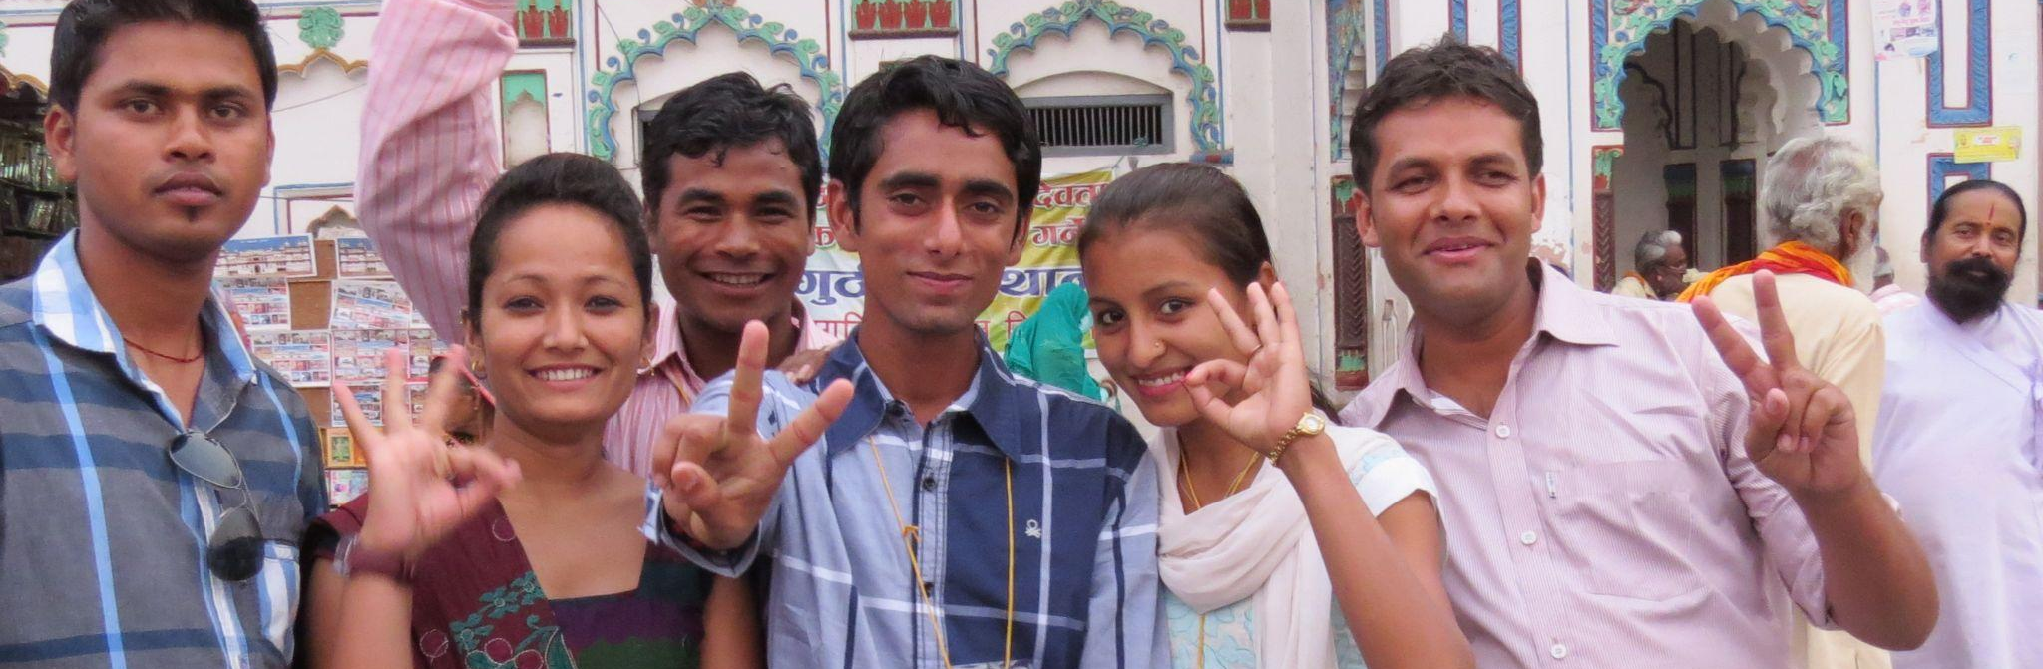
Session 1.1: Defining Conflict
Session Objectives:
Learn the definition of conflict.
Understand that it is natural and inevitable.
Be able to differentiate between direct or indirect violence.
Gain an awareness of how conflicts become violent.

Slide 4
Defining Conflict
How would you define conflict?
“Conflict is present when two or more parties perceive their interests are incompatible, express hostile attitudes, or…pursue their interests through actions that damage the other parties.”*
* Fisher S, et al. (2000) Working with Conflict: Skills and Strategies for Action. London: Zed.

Slide 5
Defining Conflict
Conflict is natural and inevitable.
Conflict can occur at an interpersonal level or at an intergroup level.
Conflicts can also be distinguished at different geographic scopes: national, regional, international, and global.
Conflict may or may not be violent.

Slide 6
Violent Conflict
Direct Violence
Activities carried out with the intention of causing harm to a person’s physical existence or property: beatings, murder, assault, and damage or destruction of property.
Indirect Violence
Refers to activities carried out with the intention of damaging or psychologically affecting someone’s dignity, self-respect, and socio-cultural identity. Structural violence, which occurs when systems and institutions are unjust and do not provide all groups equal rights, is also a form of indirect violence.​

Slide 7
How do Conflicts Become Violent?
1
2
Historical, long-term grievances between different parties.
Uneven distribution of power, and/or resources (such as food, housing, jobs, and land)​.
3
4
Opposing, clashing, or contradicting values, ideas, and/or beliefs about each other held by different parties.
Little or no communication between two or more sides who disagree.

Slide 8
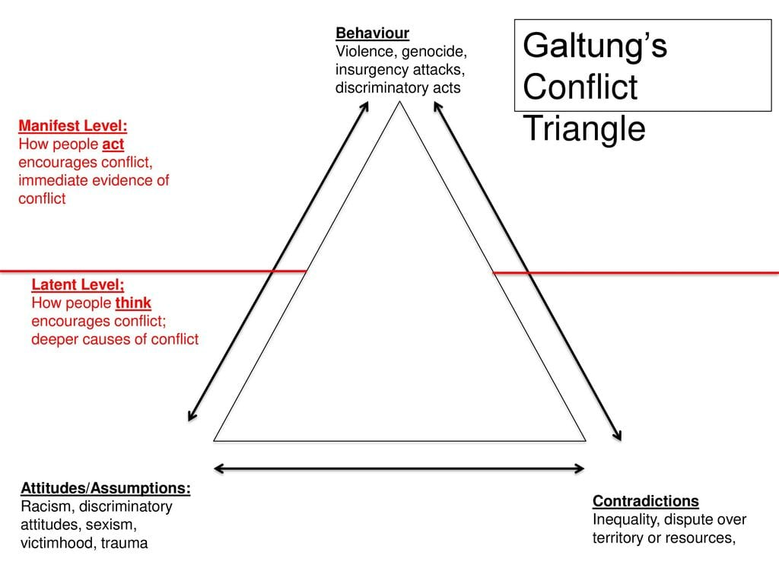
Two Levels of Conflict: Latent and Manifest

Slide 9
Activity
Think of local proverbs, expressions, or adages that denounce conflict or violence.

Slide 10
Activity
Think of local proverbs, expressions, or adages that advocate for or encourage conflict or violence.

Slide 11
Reflection
What do these proverbs/adages reveal?
Which are the most quoted/used in everyday life, and why?
What lessons can you draw from these proverbs/adages?
Are there any that are or seem to be targeted at certain categories (women/youth)?

Slide 12
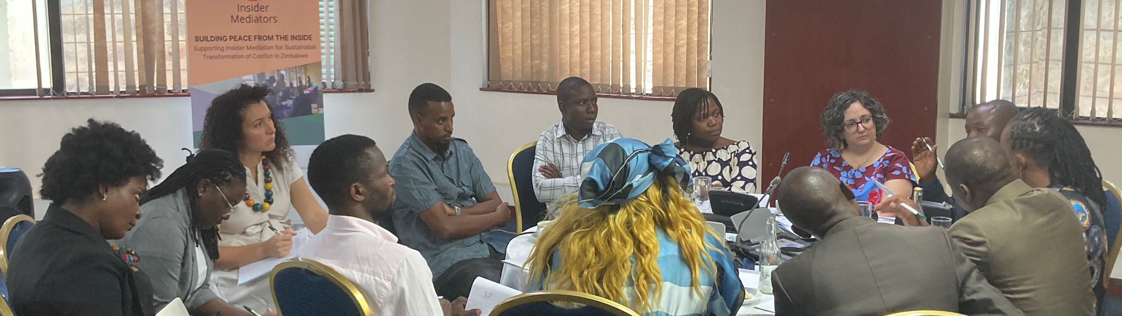
Session 1.2: Underlying Aspects of Conflict
Session Objectives:
Learn how to identify the underlying needs, emotions, values, and interests in a conflict.
Understand how to use tools like the Conflict Hippo or Conflict Onion to better understand the drivers of conflict.

Slide 13
Underlying Aspects of Conflict
To be effective as insider mediators and help resolve conflicts, we need to understand their origins and what lies below the surface-level tension or violence.

Slide 14
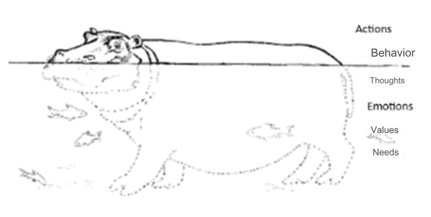
The Conflict Hippo

Slide 15
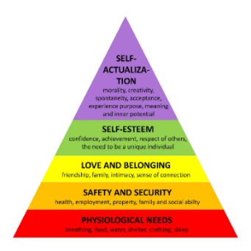
The Conflict Hippo: Defining Needs
Maslow’s Hierarchy of Needs describes that all humans have the following basic needs:
Psychological needs
Safety and Security
Love and Belonging
Self-Esteem
Self-Actualization

Slide 16
The Conflict Hippo: Values
Values are the ideas that are important to us, that determine what we find acceptable or not, 'good' or 'bad', and that influence our perceptions of morality, beauty, justice, and fairness.
Our commitment to certain values indicates how central these values are to our personality and also how difficult it will be to resolve a conflict involving these values.

Slide 17
The Conflict Hippo: Emotions
An emotion is a mental state brought on by neurophysiological changes, variously associated with thoughts, feelings, behavioral responses, and a degree of pleasure or displeasure.
Emotions play a role in how people make sense of their relationships, their degree of power, and their social status.
It takes the skill of Emotional intelligence to understand our own and others’ emotions and is the key to understanding yourself and others.

Slide 18
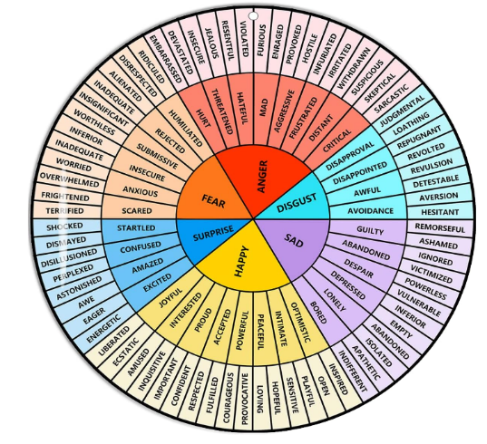
The Conflict Hippo: Emotions
The Emotions Wheel helps us identify our emotions.

Slide 19
The Conflict Hippo: Thoughts/Perception
Perception is the processing, interpretation, selection, and organization of information.
It is important to understand that each person has their own point of view, their perception of an image, a situation, a conflict, a conversation.
For each person, their perception or point of view is their reality.

Slide 20


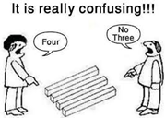
Perceptions
Perceptions: the ways in which we perceive the world and how it encourages us to think about how others may perceive the world differently.

Slide 21
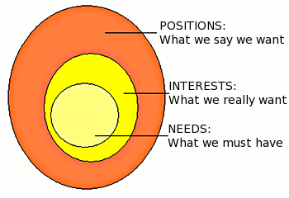
The Conflict Onion

Slide 22
Activity
You will receive a case study and work together to identify the aspects of the Conflict Hippo and complete the worksheet.

Slide 23
Reflection
How easy or difficult was it to identify the aspects of the Conflict Hippo?
What lessons have you learned from this analysis with the Conflict Hippo?

Slide 24
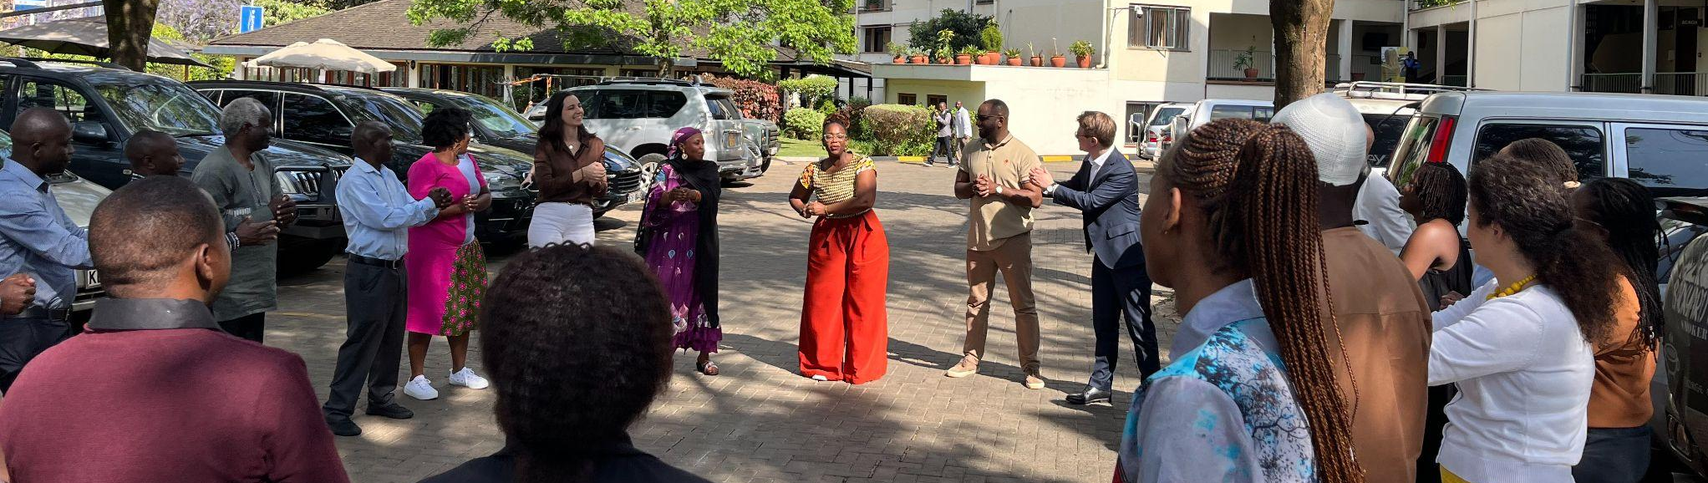
Session 2.1: Conflict Analysis and The Conflict Tree
Session Objectives:
Learn what conflict analysis is, why it is a needed skill of an Insider Mediator, and how to apply the Conflict Tree tool to analyze a conflict.

Slide 25
Conflict Analysis
Conflict analysis is a practical method of collecting information, analyzing, and understanding the context, the parties, and the conflict.
It is the first step towards any conflict resolution or transformation.
Conflict analysis informs the strategies and interventions that the mediator will take.

Slide 26
Conflict Analysis
We analyze conflicts to:
Identify the nature, patterns and dynamics of the conflict.
Understand the background and history of the conflict.
Identify all the actors involved in the conflict.
Understand the relations and perceptions of the actors.
Develop shared understanding and narrative of the situation.
Learn from failures and successes of past interventions.

Slide 27
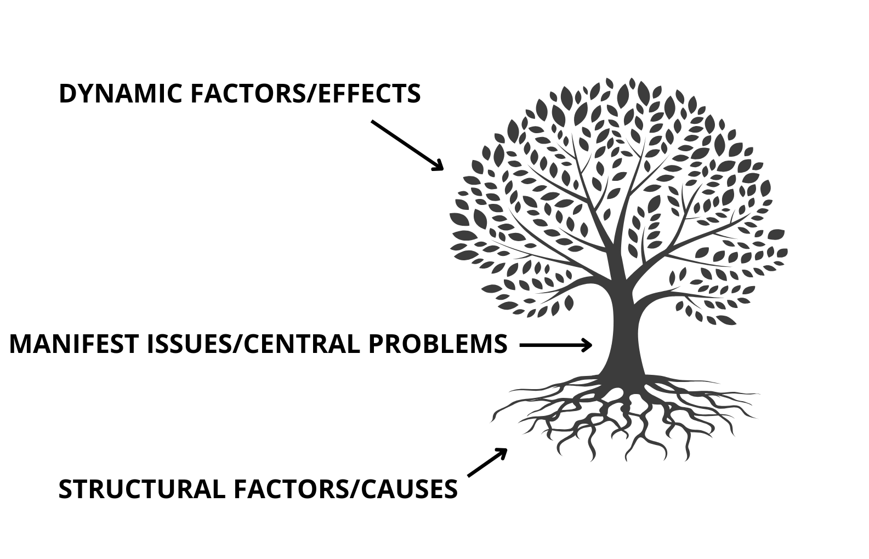
The Conflict Tree

Slide 28
Activity
Reflect on a conflict that you have had an opportunity to resolve.
Analyze the conflict and identify the Conflict Tree components by completing the Conflict Tree Worksheet.

Slide 29
Reflection
As you were analyzing, was it an easy task to separate causes from effects?
Were there issues which you felt could also fit in more than one category? Why?
How do gender norms shape understanding of the dynamic factors, manifest issues, and structural factors?

Slide 30
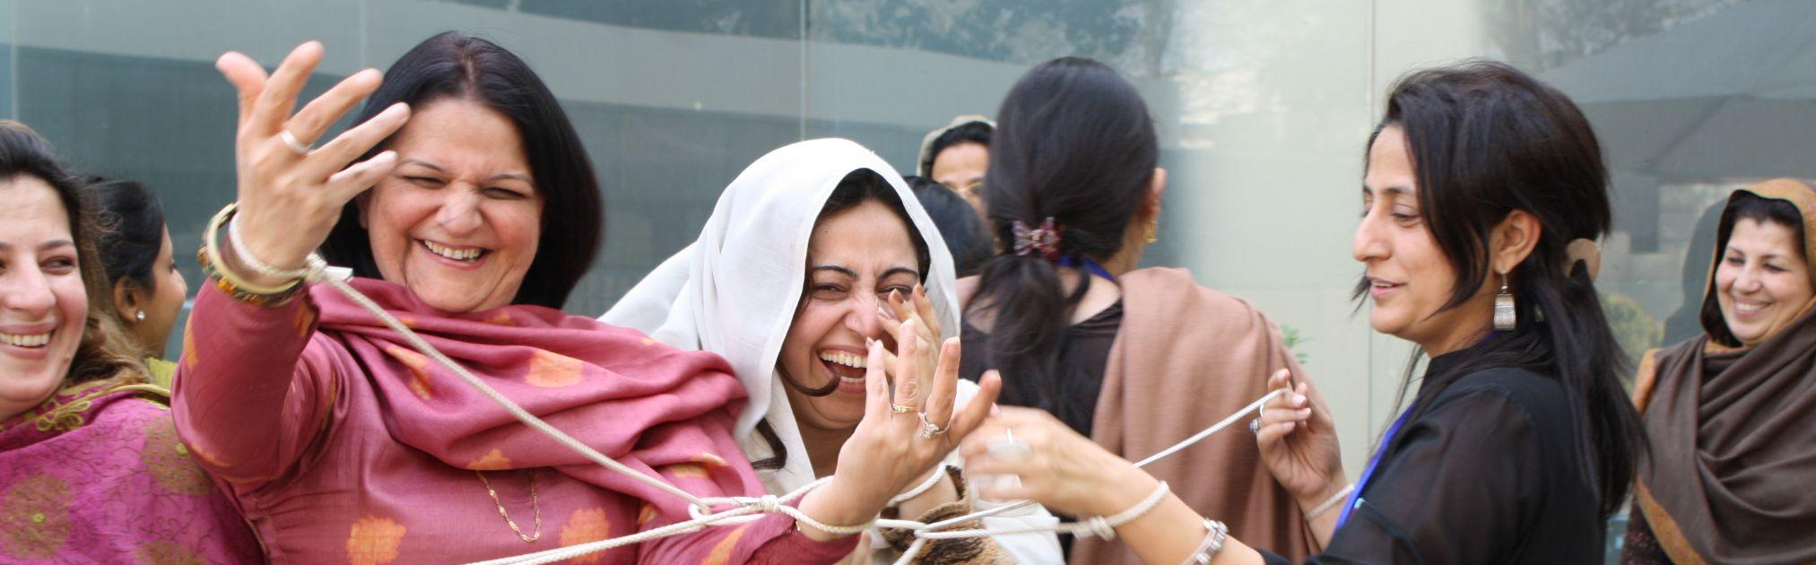
Session 2.2: Intersectionality and Gender-Sensitive Conflict Analysis
Session Objectives:
Understand why applying a gender-sensitive lens to conflict analysis is so important.
Learn how to analyze a conflicts gender dimensions.

Slide 31
Understanding Identity
Our identities play a role in how we experience life and, in particular, conflict.
Identity refers to how we define ourselves and how we are perceived by others and, at a societal level, refers to certain groupings of identity.
Our different identities may contribute to how we experience conflict. Many times this refers to our overlapping identities, not just one aspect of our identity.

Slide 32
Intersectionality
Intersectionality refers to overlapping identities - i.e. identities that we hold simultaneously that cannot be separated.
There are certain intersections of identity that can be affected differently in conflict. This is because of how much power this identity holds in society.

Slide 33
What is Gender-Sensitive Conflict Analysis and Why is it so Important?
Gender-Sensitive Conflict Analysis is the systematic study of the gendered causes, structures, stakeholders, and dynamics of conflict and peace.
Addressing common gender biases in conflict analysis will provide a more accurate and comprehensive understanding of the root causes, triggers, and drivers of conflict.

Slide 34
Gender-Sensitive Conflict Analysis…
Recognizes that women and men, girls and boys, and gender non-conforming people may have different experiences, opportunities, and constraints due to gender norms in their society.
Analyses the unequal social, political, and economic power dynamics between genders within society and how these influence opportunities and capacities for peace and security.
Addresses underlying gender dynamics in society, including discriminatory or exclusionary practices, as part of addressing the root causes of conflict.
Emerged as a practice to address the persistent lack of gender as a factor in conflict analysis, which excludes women’s different experiences, interests, and needs, and which biases planning and response against women and girls.

Slide 35
Gender-Sensitive Conflict Analysis Requires that we…
Assess the differentiated impact of armed conflict and other forms of violence on women, men, boys, girls, and gender non-conforming individuals;
Analyze the different roles of women and men, boys and girls from combatant to peacemakers, and how these have changed due to the conflict;
Address how norms relating to masculinity and femininity drive or mitigate violence and insecurity and challenge or create opportunities for peacemaking;
Expand actor mapping to identify the networks and knowledge that women, men, boys, and girls have.

Slide 36
Gender-Sensitive Conflict Analysis Questions
What are the prevailing views of the underlying causes of the conflict?
What types of violence are there and at what levels?
Who are the key actors in the conflict?
Who is involved in the peace process and how?

Slide 37
Root causes | Gender dimension.
History of armed conflict | Legacy of past wars, e.g. children born of rape, widows, orphans.
Governance and political instability | Exclusion of women from decision-making, corruption because it affects men and women differently .
Militarization | Public spending on defense reduces resources available for social services.
Heterogeneous populations | Community/separatist mobilization, gender manifestations of ethnic differences.
Demographic pressure | Unemployed young people, infant mortality.
Economic performance | Informal economy linked to the increase in the number of women working in underpaid jobs and in the informal sector.
Human development | High maternal mortality rate, women's unmet expectations in terms of education and healthcare.
Environmental pressure | Women's access to water and arable land.
Cultural influences | Cultural practices that restrict women's rights and favor men's "hypermasculinity".
International links | In the case of trafficking in women, a lack of international links means less chance of implementing the Convention on the Elimination of All Forms of Discrimination against Women (CEDAW), or of seeing women's rights as foreign to one's own culture.
The most frequently observed root causes and corresponding gender issues, according to UN Women:

Slide 38
Activity
Discuss:
What are (and have been) the roles, positions, ambitions, and frustrations of women in your community?
What are the gender dynamics in your community?
Do women and men behave differently in a conflict?
What are the attitudes, behaviors, and context of men and women before and during the conflict?

Slide 39
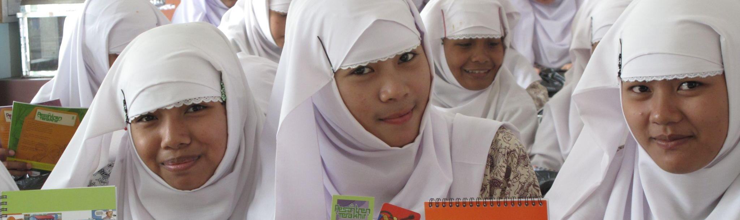
Session 3.1: The Five Basic Principles of Communication
Session Objectives:
Learn the five basic principles of communication.
Understand their importance in contributing to conflict and resolving conflict.

Slide 40
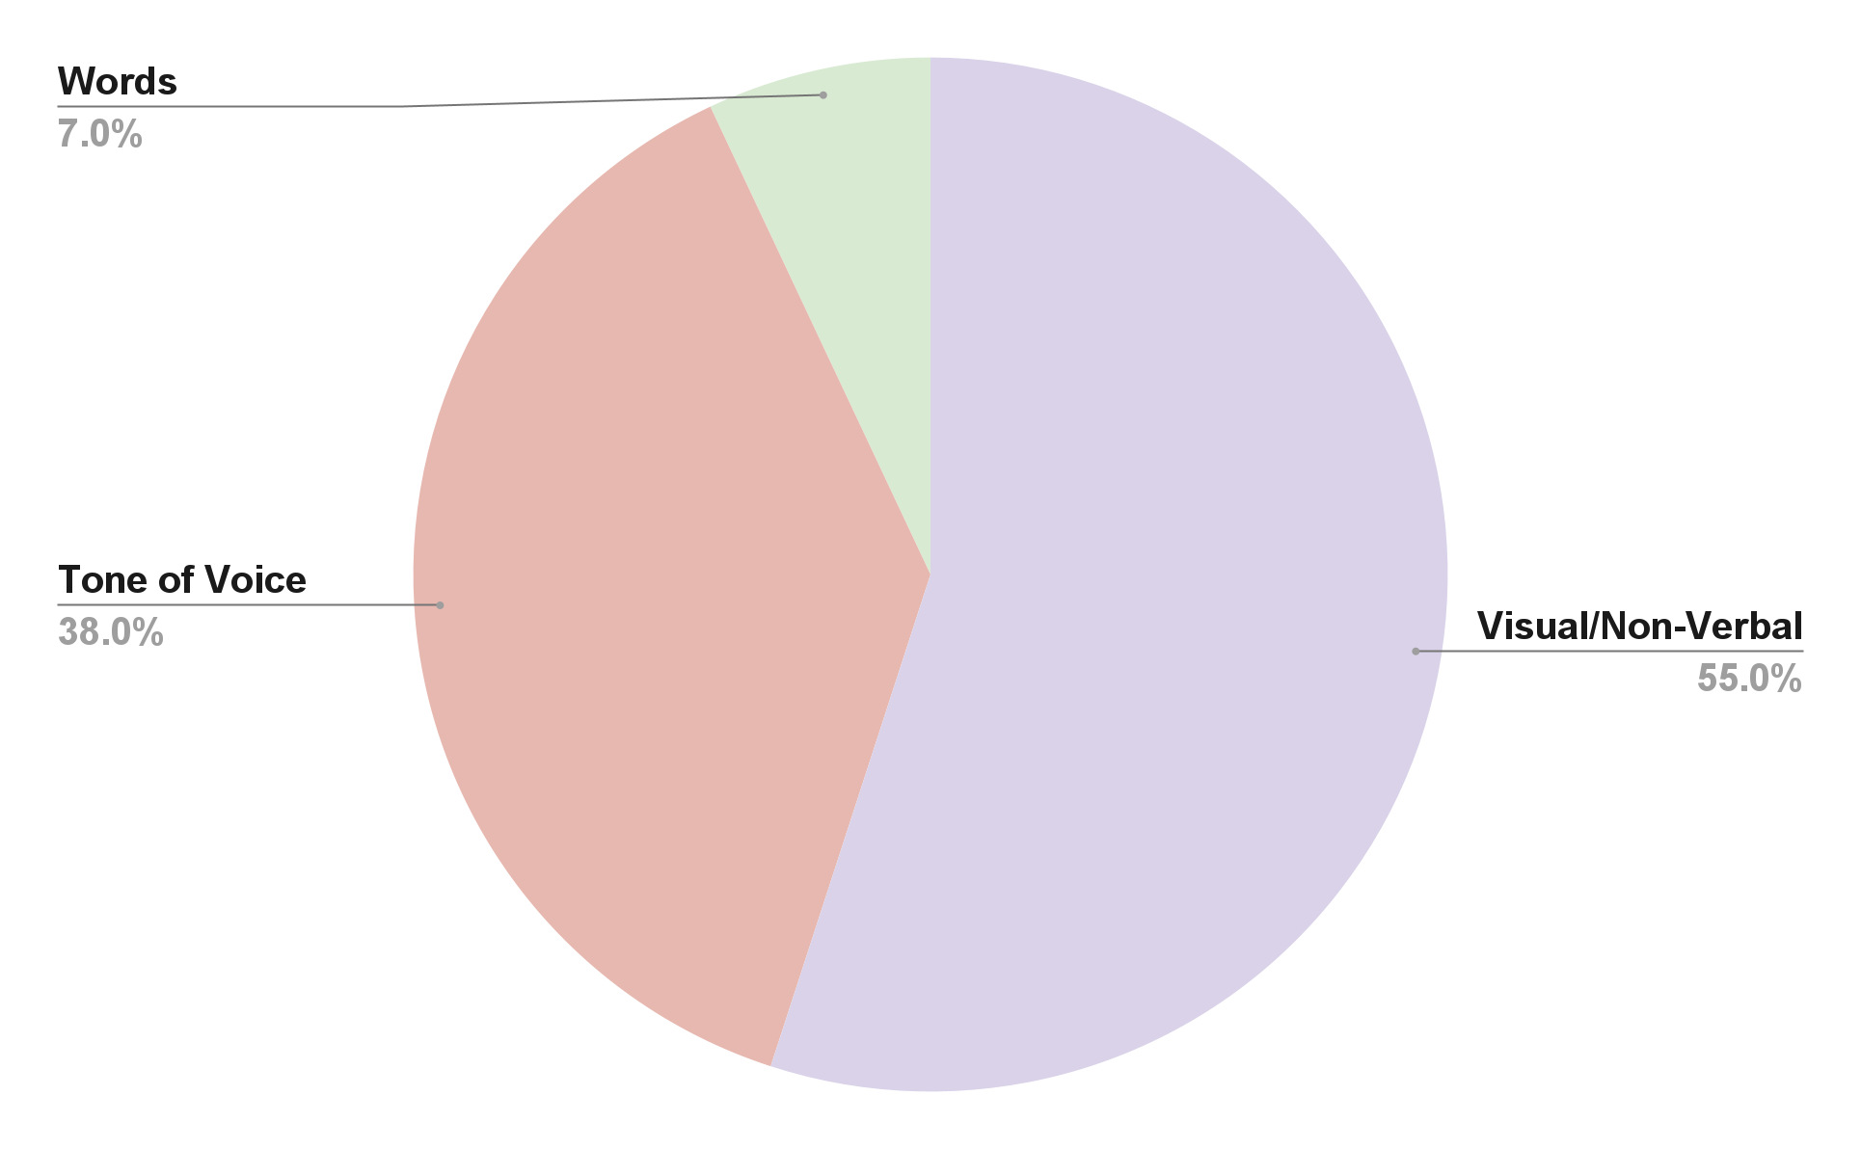
The Five Basic Principles of Communication
Principle 1: We cannot not communicate.
We are always communicating, either verbally or nonverbally.
We consciously or, more often, unconsciously interpret what the other person's body says to make sense of the words.
Three types of communication:
  Verbal/Words: 7% of the message
  Visual/Nonverbal: 55% of the message
  Paraverbal/Tone of Voice: 38% of the message

Slide 41
The Five Basic Principles of Communication
Principle 2: All communication has two aspects - Content and Relationship.
  The information content refers to what is meant.
  The relationship aspect refers to the way it is said and relies more on emotion.
  Because we are such emotional beings, the way the words are said is more meaningful than the words themselves.
  The relationship determines the success or failure of the communication.

Slide 42
The Five Basic Principles of Communication
Principle 3: The nature of the relationship depends on the punctuation of the communication sequences.
We often default to ask: Who is in the right or wrong? Who is responsible for starting the conflict? Yet, in reality, conflicts are much more blurry than right and wrong.
The perception of the situation and the relationship is not the same between two parties. Cause and effect become confused and indistinguishable.

Slide 43
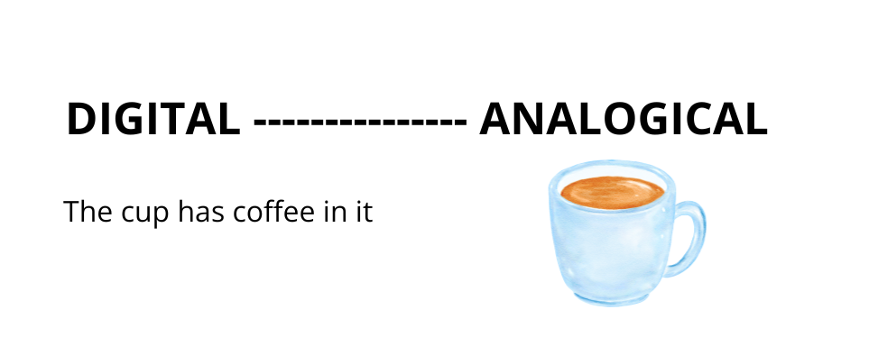
The Five Basic Principles of Communication
Principle 4: Communication is simultaneously digital and analog.
Digital communication uses the verbal: a word for everything, taking into account the necessary nuances. It is structured and precise.
Analogical communication uses everything else: images, behavior, noises, etc. It cannot be as precise because it opens the door to many interpretations.
The information content of a communication is digital while the relationship or feelings are defined by analogical communication.

Slide 44
The Five Basic Principles of Communication
Principle 5: Any communication exchange is symmetrical or complementary depending on whether it is based on equality or difference.
A complementary relationship is defined by the difference between the two interlocutors.
  This difference can be related to hierarchical status, social level, age, level of competence, etc. his is often what we refer to as power dynamics.
A symmetrical relationship is defined by the parity between the two interlocutors.

Slide 45
Activity
We will now engage in a role play and discern what aspects of the five principles are exhibited.

Slide 46
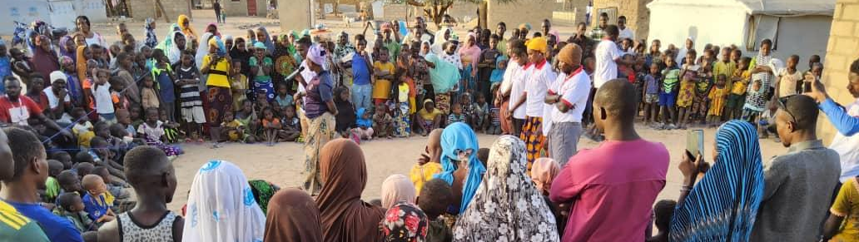
Session 3.2: Active Listening
Session Objectives:
Learn what active listening is, why it is essential to conflict and conflict transformation, and how it can be practiced.

Slide 47
Active Listening
A communication technique which involves using questioning and rephrasing to ensure that the other person's message has been understood as well as possible, and to demonstrate this.
This approach is characterized by the expression of respect and warm trust towards the interlocutor so that they break their defenses and express themselves freely.

Slide 48
The Five Imperatives of Active Listening
1
Acceptance
2
Experience-Focused
Accept the other person as they are; an attitude marked by respect and consideration to encourage trust and show a real interest.
Focus on what the other person is experiencing and not just on what they say.
3
Person-Focused
4
A Foundation of Respect
Show more interest in the other person rather than the problem itself; see the problem from the other person's point of view.
Give the other person the assurance that you respect their way of living or seeing things without encroaching on their domain.
5
Mirroring
Echoing what the other person feels: "so, you feel deeply that...". The art here is to highlight the feelings that accompany the other's words.

Slide 49
Two Fundamental Attitudes of Active Listening
Non-directiveness
Focus on the "other" without pressuring or influencing the other's attitude.
While listening, put aside thoughts of who is right/wrong, what someone should do, or what you would do if you were in that situation.
Be aware of biases and check whether these affect your listening.
Empathy
Empathy is wanting to experience the other person's inner world as if it were our own.
Consider the speaker as a person and not as a party to a conflict.
Acknowledge how the person feels about being a party to the conflict.

Slide 50
Skills to Practice Active Listening…
Stay silent while the other person is speaking.
Stay focused on what the other person shares (including their body language) and how they feel.
Show interest and empathy.
Synthesize and reformulate.
Ask meaningful questions.

Slide 51
Active Listening Tools: Reflecting
Reflecting and summarizing: Show you have understood the other person, show empathy, and thereby clarify issues as well as build trust.
Three types of reflecting:
  Reflecting while validating: Reflecting is when the hearer says back to the speaker what the hearer believes the speaker has just expressed, using language that is close to the speaker’s own.
  Reflecting while summarizing a large chunk of information into a smaller one: Summarizing entails a larger piece of conversation. The hearer tells the essential information and ideas expressed by the parties.
  Reflecting while summarizing logic, rather than exact content: A useful way of checking if you have understood not just the content from one party, but also some aspects of how they think and argue, is to reflect their logic or their style of arguing.

Slide 52
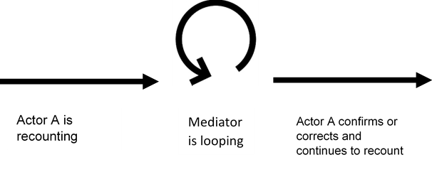
Active Listening Tools: Looping
Reproducing in one’s own words, what one has heard.
The Loop of Understanding:
Looping consists of three steps:
  Person “A” sends the message to person “B”;
  Person “B” repeats how she or he has understood the message and asks if it is correct;
  Person “A” confirms to person “B” if she or he has understood the message correctly, by saying “yes” or “no”. If “no”, person “A” tries again, and the looping starts over.

Slide 53
Activity
Break into pairs.
Decide who will be Person A and who will be Person B.
Person A is the first speaker and Person B is the listener.
Person A chooses a topic that interests him/her/them and talks about it for three minutes.
While they are talking, Person B listens carefully, and is not allowed to speak or interrupt Person A.
When the time is up, Person B will have one minute to summarize what he/she/they have heard. Person B cannot ask A any questions, they have to rely on their memory and their ability to summarize what they have understood.
Then Person A shares with Person B how inaccurate the summary was, somewhat or completely accurate.
Then we reverse roles.

Slide 54
Reflection
How did you feel during this exercise?
At the end of the exercise, how well did you remember what was said?
What was easy? Difficult?
Were there any thoughts that came to mind or anything that interfered with your ability to listen?
What would help you to improve your listening skills?
Do you have any additional questions?

Slide 55
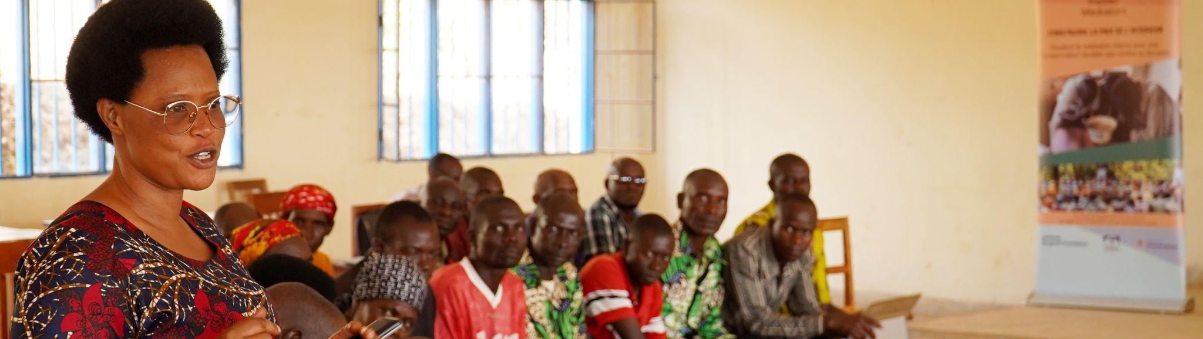
Session 3.3: Non-Violent Communication
Session Objectives:
Learn what Non-Violent Communication is, understand the NVC process, and be able to apply this approach as Insider Mediators.

Slide 56
What is Non-Violent Communication?
Non-Violent Communication (NVC) is a method of communication which aims to prevent and manage violence and the breakdown of dialogue with oneself and with others.
NVC is a form of communication that focuses on compassion, common ground, and resolving conflicts.
NVC is a skill we can develop so that how we speak to others and share our feelings and interpretations repairs and builds relationships rather than fracturing relationships with blame or resentment.

Slide 57
The ONFR Model
O for Observation: Observe what just happened and express this observation.
    For example: Avoid saying: "You are always late/unpleasant/sad!" Instead, one would say what they observe: "We had an appointment at 6pm. It's 6:15pm.”
F for Feeling: Express how the situation or observation made us feel.
    For example: "When I hear these words, I feel belittled and sad. How do you feel?" or “When you arrive 15 minutes late, it makes me feel upset and I perceive this as not being cared for.”
N is for Need: Behind every emotion is a need that is either satisfied or unsatisfied.
    For example, “I am feeling like my time isn’t being valued and I need to feel a sense of respect and consideration.”
R for Requests: Express what we’d like to experience moving forward.
    For example, “In order for me to feel respected and valued, can you inform me ahead of time if you will be arriving late?”

Slide 58
Activity
You will engage in a pair activity to practice NVC.
In each round, one person will express a situation or issue that they are struggling with, and the other person will practice responding with NVC.
The person responding should use the OFNR model to express what they observed, how it made them feel, what needs were not being met, and then make a request for how the situation could be improved.
Each person will have a chance to be the speaker and the listener.

Slide 59
Reflection
How was that activity for you? How did you feel practicing NVC?
How can NVC be applied in various personal and professional contexts?
How can NVC improve relationships and promote mutual understanding?

Slide 60
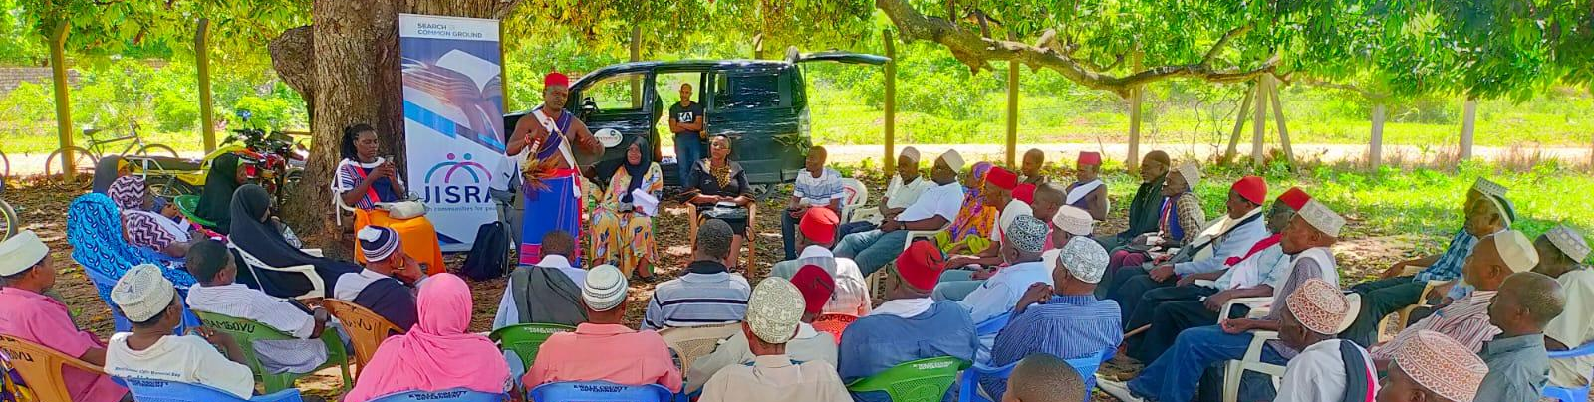
Session 3.4: Conflict Transformation Methods Overview
Session Objectives:
Understand the different methods of conflict transformation and identify when to select which method.

Slide 61
What different methods of conflict transformation are you aware of?

Slide 62
Advocacy
A deliberate process aimed at influencing decision-makers on the development, change and implementation of policies or laws in favor of people and/or communities affected by a given problem or situation.
Mainly used by civil society organizations (CSOs) and non-governmental organizations (NGOs) in the defense of a cause and to achieve a desired change.

Slide 63
Dialogue
A face-to-face interaction between people with different backgrounds, convictions, and opinions, in which they respect each other as human beings and are prepared to listen to – and learn from – each other deeply enough to inspire a change of attitudes.
Dialogue promotes a win-win, collaborative approach.
Dialogue can be a more time consuming process and is best implemented over a series of phases and time.

Slide 64
Negotiation
A means of communication designed to reach an agreement when you and the other side have some shared and some opposing interests.
It can also be an intervention strategy for the resolution of a larger conflict through a process of talks between conflicting parties without the support of a third party.
Negotiation often requires compromise.
The result of this approach remains in the hands of the conflicting parties, not an external party.

Slide 65
Mediation
“A process whereby a third party assists two or more parties, with their consent, to prevent, manage or resolve a conflict by helping them to develop mutually acceptable agreements.”*
Mediation promotes a win-win, collaborative approach.
The result of this approach remains in the hands of the conflicting parties, not an external party.
* The United Nations Guidance for Effective Mediation (2012, p.4)

Slide 66
Arbitration or Litigation
A highly formal process requiring knowledge of the legal system and usually involves individuals with license to practice the law.
Promotes a win-lose approach because parties then have to “prove” they are “right” and the other side if “wrong.”
The result of this approach remains in the hands of an external party, not the conflicting parties.

Slide 67
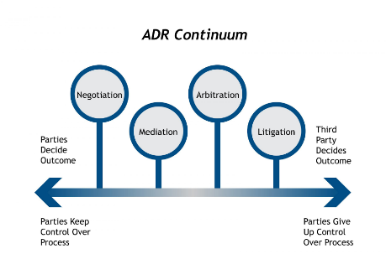

Slide 68
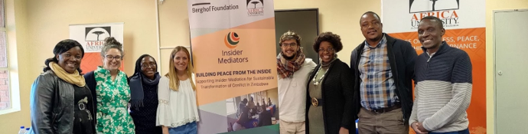
Session 3.5: Mediation Ethics and the Role of the Insider Mediator
Session Objectives:
Understand what mediation is, how it can be applied, and understand the role, skills, and ethics needed for mediators.

Slide 69
Mediation
According to the UN, mediation is “a process whereby a third party assists two or more parties, with their consent, to prevent, manage or resolve a conflict by helping them to develop mutually acceptable agreements”.

Slide 70
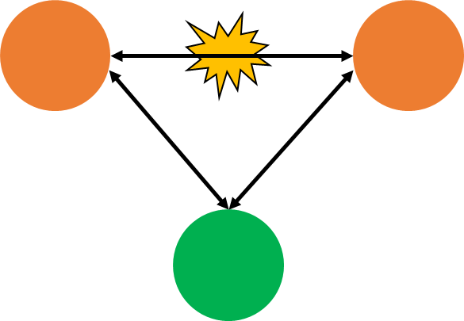
Mediation
The EU describes mediation as, “a way of assisting negotiations between conflict parties and transforming conflicts with the support of an acceptable third party.

Slide 71
Mediation Ethics
A set of general and ethical principles in mediation practices at both national and international levels.

Slide 72
Mediation Ethics: Consent
Consent: Mediation is a voluntary process in which parties approve to participate, as opposed to court trials that oblige parties to attend.

Slide 73
Mediation Ethics: Impartiality/Inclusivity
Mediation should be a balanced process in which parties are treated fairly and whose perspectives are respectfully integrated.
Avoid favoritism, bias, or judgment towards one party.
  Bias is preconceived prejudice or favoritism towards one group over another. We can have explicit or implicit bias – biases we are aware of or biases that are subconscious.
  Inclusivity is the process of improving the terms of participation, representation, and decision making.
The UN defines inclusion in peace processes as “the extent and manner in which the views and needs of parties to conflict and other stakeholders are represented, heard and integrated into a peace process”.

Slide 74
Mediation Ethics: Inclusion
Why is inclusion so important? What are the benefits of inclusion?
Empower people’s investment in peace;
Ensure that current power dynamics are not perpetuated;
Reduce grievances;
Overcome prejudice and stereotypes;
Foster peaceful relations across differences;
Find strength in diversity;
Strengthen social responsibility and commitment;
Heighten legitimacy and garner support of the process;
Mobilize resources for creativity and co-creation of society;
Create a cohesive societal web as a collaborative support system.

Slide 75
Mediation Ethics: Confidentiality
Confidentiality: The mediator is bound not to disclose any information s/he/they have become aware of during the mediation.

Slide 76
Mediation Ethics: Self-Determination
Self-determination: Parties have ownership of the process and the responsibility to find a mutually agreed solution. The role of the mediator is to foster dialogue and facilitate a voluntary resolution of a dispute, not to find solutions or impose an agreement.

Slide 77
Mediation Ethics: Conflict of Interest
Conflict of interest: The mediator should not have an interest in the outcome. If the mediator believes there is a conflict of interest (knowing, favoring one party, etc), the mediator should step down.

Slide 78
Mediation Ethics: Quality
Quality: Refers the mediator’s ability to be aware of their own judgments and assumptions so as not to negatively affect the process. The mediator should not offer opinions on who is right or wrong. A mediator should conduct the mediation fairly, diligently, with sensitivity, civility, and respect.

Slide 79
Mediation Ethics: Competence/Preparation
Competence/Preparation: Training and experience are key in mediation. Typically, it takes substantial training, practice, and experience to gain accreditation and credibility.

Slide 80
Mediation Ethics: Safety
Safety: Mediation should take place in a physically safe place where all parties feel comfortable.

Slide 81
Mediation Ethics
Which of these ethics do you feel most confident and competent in, and which do you feel you need to strengthen?

Slide 82
Inside Mediators
Insider Mediators are “an individual or group of individuals who derive their legitimacy, credibility and influence from a socio-cultural and/or religious – and, indeed, personal - ‘closeness’ to the parties of the conflict, endowing them with strong bonds of trust that help foster the necessary attitudinal changes amongst key protagonists which, over time, prevent conflict and contribute to sustaining peace.”

Slide 83
Activity
What are the roles you would like to have in peace processes?
How can the inclusion of insider mediators improve the effectiveness of peace processes in your community?
Can you think of specific examples of how insider mediators have helped to resolve conflicts in your community?
Brainstorm a list of actions that could be taken to further involve insider mediators in peace processes in your community.

Slide 84
Reflection
What challenges may arise in implementing these actions and how can they be addressed?
How can the inclusion of insider mediators help ensure that the peace mediation process is locally informed, inclusive, and effective?
How do you think the inclusion of insider mediators can improve the effectiveness of peace processes in your community? Consider the benefits of local knowledge and understanding of cultural and social dynamics.
What challenges might arise in implementing the action steps proposed to involve insider mediators in peace processes? How can these challenges be addressed?

Slide 85
Activity
You will receive a case study/scenario in small groups and consider how to apply the mediation ethics we reviewed to your role as an IM in this scenario.
Discuss what you need to consider so that the mediation abides by the following ethics:
Do you have any biases that would prevent you from being impartial and fully inclusive as an IM in this scenario?
Do you have any issues that would be of concern regarding confidentiality or conflicts of interest?
Are there any safety concerns for you or the parties?
How can you ensure a quality mediation where you are competent and prepared as a mediator?

Slide 86
Case Study
Paul and Bob (adapted from Charlton, R and Dewdney, M 1995 The Mediator's Handbook: Skills and strategies for practitioners. LBC Information Services, Sweet & Maxwell, Ltd: London.)
Paul and Bob are school friends who left school and set up a juice bar business together. Paul’s parents lent him $30,000 towards the business and he still owes them $15,000. The business cost $150,000 to set up. Bob contributed $10,000 towards the business and he owes his parents $5,000. Paul and Bob still owe the State Bank $110,000. Six months ago Bob became engaged to a university student, Mary, who is studying to be a doctor and will be studying for another 3 years. They plan to marry in three months time and Mary will be financially dependent on Bob.
The juice bar has been really successful. Bob does most of the management and staffing side of things and Paul does the financial side. Bob and Paul worked really well together up until last year when Bob started going out with Mary. Bob started spending a lot less time at the business and Paul found himself having to organise the staff as well as do the financial things. Paul is fed up and wants to dissolve the partnership and look for new partners in the business. They have decided to try mediation (because they did the SCRAM competition at school) to see if they can find a resolution before things get worse.

Slide 87
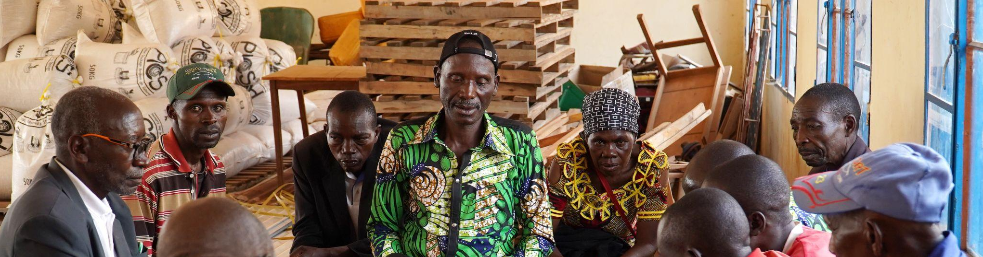
Session 3.6: Mediation Preparation
Session Objective:
Understand how to prepare for a mediation.

Slide 88
Mediation Preparation Checklist: Assess Risk
Assess personal risk: The mediator should assess if and how a specific mediation is posing a risk for themselves and participants. Risks should be minimized and, if they are still too high, the mediator should consider not mediating that case. Remember, practicing Do No Harm is essential in peace processes.

Slide 89
Mediation Preparation Checklist: Research
Research context and pre-sessions: Research the history of the parties and of their relationship, and the current situation on the ground.

Slide 90
Mediation Preparation Checklist: Co-Mediation Coordination
Co-mediation coordination: If you are not the only mediator, make sure you coordinate. How are you going to divide roles? How will you make sure that you are both equally involved? Check-in about methods and styles of mediation as these can be very different.

Slide 91
Mediation Preparation Checklist: Participation
Participation: Who needs to be involved to reach the goal? Who needs to be involved to make the process credible, sustainable, and inclusive? Will there be any pushback to involve these parties? What third parties need to be involved? Who will convene, facilitate or mediate the process? What is the role of the third party?

Slide 92
Mediation Preparation Checklist: The Mediation Space
The space where the mediation occurs must be acceptable to all parties, foster cooperation, be practical (with your budget, logistical arrangements), and, in some cases, be symbolic.
  If it is a closed space, the mediators should sit closest to the exit for security reasons;
  The parties should sit the closest to the mediator;
  If needed, there should be translators;
  There should also be plenty of necessary material: pens, papers, tissues, water, tea, coffee, etc. Make sure everyone is comfortable.

Slide 93
Mediation Preparation Checklist: Time, Format, Sequence
Time: When, how long, and how often will actors meet?
Format: What different formats will be used (e.g. working groups, plenary, side talks, etc.)? How do they all link?
Sequence: How will the agenda be set, issues identified and structured (e.g. sequence, parallel, circular)?

Slide 94
Mediation Preparation Checklist: Procedural Questions
Procedural questions: What is the internal and external communication strategy? What are decision making procedures (by full or partial consensus, majority vote, etc.)?

Slide 95
Mediation Preparation Checklist: Funding
Funding: How will the process be financed? Ensure any financing is impartial.

Slide 96
Mediation Preparation Checklist: Logistics
Logistics: How will participants be invited, arrive, accommodated, with security maintained?

Slide 97
Mediation Preparation Checklist: Goal/Vision
Goal/vision (knowing why you are engaged): What vision do you have for the process? What is the concrete goal you are trying to achieve?

Slide 98
Mediation Preparation Checklist: Process Logic
Process logic: What is the logic behind the process design? What is the ‘theory of change’? How does it link to other processes?

Slide 99
Activity
You will receive a case study/scenario in small groups and answer the preparation checklist questions.
  Identify Participants
  Consider the mediation space (i.e. the venue and set-up)
  Determine time, format, and sequence
  Answer procedural questions: What is the internal and external communication strategy? What are decision making procedures? By full or partial consensus, majority vote, etc.
  Identify your goal/vision: What vision do you have for the process? What is the concrete goal you are trying to achieve?
  Identify the process logic: What is the logic behind the process design? What is the ‘theory of change’? How does it link to other processes?
  ow will the process be financed?
  How will participants be invited, arrive, how will they be accommodated, how will security be maintained etc)
  What third parties need to be involved?

Slide 100
Case Study
Paul and Bob (adapted from Charlton, R and Dewdney, M 1995 The Mediator's Handbook: Skills and strategies for practitioners. LBC Information Services, Sweet & Maxwell, Ltd: London.)
Paul and Bob are school friends who left school and set up a juice bar business together. Paul’s parents lent him $30,000 towards the business and he still owes them $15,000. The business cost $150,000 to set up. Bob contributed $10,000 towards the business and he owes his parents $5,000. Paul and Bob still owe the State Bank $110,000. Six months ago Bob became engaged to a university student, Mary, who is studying to be a doctor and will be studying for another 3 years. They plan to marry in three months time and Mary will be financially dependent on Bob.
The juice bar has been really successful. Bob does most of the management and staffing side of things and Paul does the financial side. Bob and Paul worked really well together up until last year when Bob started going out with Mary. Bob started spending a lot less time at the business and Paul found himself having to organise the staff as well as do the financial things. Paul is fed up and wants to dissolve the partnership and look for new partners in the business. They have decided to try mediation (because they did the SCRAM competition at school) to see if they can find a resolution before things get worse.

Slide 101
Inclusion in Mediation
Mediations are more successful and have more enduring agreements when the process is inclusive of more than just the 'powerful' actors.
Each context is different, and it is important for local stakeholders to identify the various groups which would be needed for a process to be deemed fully inclusive within their own communities and culture.

Slide 102
Activity
Think about your own contexts and the challenges and dilemmas that you might be facing when thinking about inclusion and trying to make processes as inclusive as possible.
What are the limitations and trade-offs of inclusivity?
Are there circumstances in which the principle of inclusivity is not desirable?

Slide 103
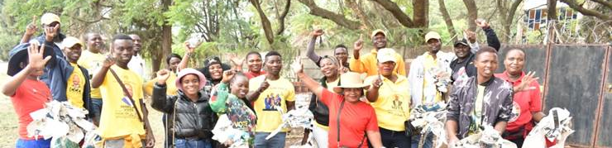
Session 3.7: The Mediation Process Design
Session Objectives:
Understand mediation process design guidelines and learn how to apply this.
Understand key considerations and requirements for mediation agreements.

Slide 104
Mediation Process Design Guidelines
The role of the mediator is to design a well-rounded process in which the disputants can discuss the content. The process is as important as content and essential to:
  Ensure that the process fits the conflict and context;
  Ensure appropriate role division;
  Ensure that process and mediator is seen as impartial;
  Ensure that all necessary actors are part of the designing some aspect of the process;
  Make sure the mediation design is feasible.

Slide 105
Mediation Process Design Guidelines
Understand the importance of language:
As you prepare, be careful with the language you use. You do not want to identify people as ‘victim’, ‘offender’, etc., but rather keep an open mind.
Language that is in any way offensive or non-neutral should be avoided at all costs.

Slide 106
The Mediation Process: Introduction
All mediations begin with an introduction: Ensuring parties understand it is a voluntary process and agreement on any ground rules.
  Welcome and introductions, confirm names of people.
  Check if the conflict is in court or under investigation by any other institution.
  Explain what is mediation and your role.
  Explain that the process is confidential.
  Discuss possible outcomes such as increased understanding, oral or written agreement, or the possibility of having another meeting.
  Discuss any ground rules and guidelines.
  Specify length of session.

Slide 107
The Mediation Process: Analysis of Issues
The mediator facilitates analysis of issues and needs through listening, visioning and questioning:
Both parties explain their version of the facts.
The mediator listens empathically and listens for positions, interests, and feelings.
The mediator takes notes (separating the people from the problem).
The mediator reflects and summarizes.

Slide 108
The Mediation Process: Promote Understanding
Throughout, the mediator promotes an understanding of key and common issues:
The mediator asks follow up, open ended questions, listens for proposals, ideas for resolution, and sets an agenda of key topics.

Slide 109
The Mediation Process: Encourage Parties to Suggest Solutions
Encouraging parties to suggest solutions:
The mediator guides a brainstorming of possible solutions for each item on the agenda.
It is wise to start discussing items on which there is already some agreement or on which it is easier to reach agreement.
The mediator takes notes on the agreements reached.

Slide 110
The Mediation Process: Conclusion
Conclusion of the mediation:
A mediation concludes with a total, partial, or no agreement.

Slide 111
Activity
In small groups, consider the case study and discuss:
What would you include in your introduction?
How will you facilitate an analysis of issues and needs through listening, visioning and questioning? What positions, interests, and feelings are or might be present?
Consider what follow up, open ended questions, ideas for resolution, and topics may be brought up.
How will you encourage parties to suggest solutions? How will you guide a brainstorming of possible solutions for each item on the agenda?
What might an agreement look like?

Slide 112
Case Study
Paul and Bob (adapted from Charlton, R and Dewdney, M 1995 The Mediator's Handbook: Skills and strategies for practitioners. LBC Information Services, Sweet & Maxwell, Ltd: London.)
Paul and Bob are school friends who left school and set up a juice bar business together. Paul’s parents lent him $30,000 towards the business and he still owes them $15,000. The business cost $150,000 to set up. Bob contributed $10,000 towards the business and he owes his parents $5,000. Paul and Bob still owe the State Bank $110,000. Six months ago Bob became engaged to a university student, Mary, who is studying to be a doctor and will be studying for another 3 years. They plan to marry in three months time and Mary will be financially dependent on Bob.
The juice bar has been really successful. Bob does most of the management and staffing side of things and Paul does the financial side. Bob and Paul worked really well together up until last year when Bob started going out with Mary. Bob started spending a lot less time at the business and Paul found himself having to organise the staff as well as do the financial things. Paul is fed up and wants to dissolve the partnership and look for new partners in the business. They have decided to try mediation (because they did the SCRAM competition at school) to see if they can find a resolution before things get worse.

Slide 113
Case Study
Additional details on Paul: Paul feels really annoyed at Bob because he feels that if it wasn’t for Paul’s arranging the financing for the business then there would have been no business and it certainly wouldn’t have been the success it is. Paul feels that Bob has never acknowledged this and he feels that if he were a partner with someone more committed to the business, then it would work better and that they could grow the business nationally.
Additional details on Bob: Bob feels that Paul is jealous of his relationship with Mary and that that is the real reason that he wants to dissolve the partnership. Now that Bob is engaged and will have to support Mary there is no way that he wants to leave the business as it makes enough profit for him and Mary to enjoy a fairly nice lifestyle. Bob acknowledges that he hasn’t been working as hard at the business as he did before but he thinks that the business is fairly stable and he doesn’t think it requires him around every day. He also doesn’t want to expand the business, as he knows that a lot of businesses go under when they expand before they are ready.

Slide 114
Reflection
How was this process for you?
What did you find easy or difficult?

Slide 115
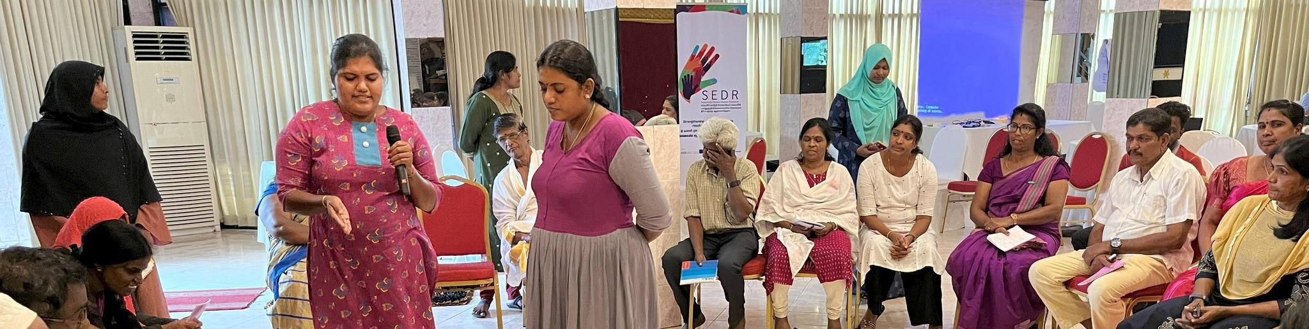
Session 3.8: The Mediation Agreement
Session Objectives:
Understand components of a mediation agreement.
Learn tools you can apply if a mediation reaches a gridlock.

Slide 116
Essential Elements of a Mediation Agreement
Identification of the Parties: The names and addresses of the parties to the dispute.
Summary of the Dispute: A brief description of the nature of the dispute.
Terms of Settlement: The specific terms and conditions under which the parties have resolved their differences.
Payment Provisions: Details of any payments that must be made by one party to the other.
Confidentiality Provisions: A clause restricting the parties from disclosing the agreement's contents to third parties.
Signature Blocks: Space for the parties to sign and date the agreement.

Slide 117
Mediation Agreements Should…
Be precise: Avoid ambiguous words such as "soon, reasonable, cooperate", and be clear about deadlines.
Be balanced: Everyone must gain something and commit to doing or not doing something.
Be realistic: Agreements should be doable, durable, inclusive, understandable, iterative, conflict sensitive.
Be clear and simple: An overly complicated agreement may lead to different interpretations or misunderstandings resulting in further conflicts. Each party must know exactly what it has agreed to.
Be forward-looking: Make provisions for revision of the agreement, set up a monitoring mechanism or a procedure for handling future disputes.

Slide 118
When Agreements are Hard to Reach: Strategies for Gridlock
Normalize/reframe: Make the parties feel at ease, make them know that what they are going through is typical in their situation. Reframe by changing language to less aggressive, in a way that the other side might hear.
Silence: Allow for there to be silence, don’t feel pressured to say something.
Provide perspective: Point out what you see that is making them stuck.
Break-down Problems: Break down the issue they seem to be stuck on and focus first on the topics that are easiest to mediate.
Stroking: Compliment both parties for their effort and for their choice of coming to mediation. Acknowledge merits and be balanced.

Slide 119
When Agreements are Hard to Reach: Strategies for Gridlock, Cont’d.
Break: Take a break if people look stressed.
Humor: Lighten the mood, if you are absolutely sure the joke will work well on both parties.
Future cast: Ask where they would like to see themselves in a year, what type of solution they are envisioning, and what will happen if they don’t come to an agreement.
Appreciative Inquiry: Reframe something in a positive light.
Reality test: How is it going to work in real life?
BATNA: What is their best alternative to finding a commonly shared solution? Is there an alternative to finding a solution? What will happen if they do not find a solution?

Slide 120
Activity
In small groups, you will conduct a mock mediation.
You will assign roles for each group member: one mediator, one representative from each party in conflict, and an observer.
  The mediators are insiders from the community, and they should use their knowledge of the community and their relationship with the parties to facilitate mediation and reach a peaceful agreement.
You’ll have approximately 20 minutes to prepare for the mediation session.
You will then have 20 minutes to conduct a mock mediation.

Slide 121
Case Study: “This is my land!”
Two individuals, Fatuma and Hussein, are in conflict with one another and solicit the help of a mediator. Fatuma is a middle-aged female, has the legal ownership of the land by inheritance from her father. She lives in Germany (of the Somali Diaspora), and has an emotional, but remote attachment to the land. Hussein is a male in his mid-20s with an intimate relationship with the land. He grew up and still lives on this land, even though it was grabbed by his father, since Fatuma´s father had fled with his family. He has no formal education, but built his life and income on this land on which he is taking care of his family and is using the income to educate his three siblings.
Fatuma contacts her relatives to ask them about the land and discovers what has happened to it. Her relatives advise her not to claim the land as Fatuma and her family belong to the weaker clan in terms of power and thus fear a violent reaction. However, she is not willing to give up without trying. Hussain hears through the grapevine about Fatuma´s imminent arrival in Somalia. He knows he doesn’t legally own the land, so he is concerned. He wants to defend the land he has called home since birth. He knows that he will get support from his clan. Fatuma flies to Mogadishu. She finds Hussain’s number and they attempt to discuss the issue, but reach a stalemate. They propose that they elicit the help of an insider mediator to assist with finding a solution they can both agree on.

Slide 122
Reflection
How did the role-play activity help you understand the importance of insider mediators in conflict mediation?
What strategies did you use to mediate the conflict in the scenario?
What challenges did you face as an insider mediator? How did you overcome these challenges?
How can insider mediators use their knowledge of the community to facilitate conflict mediation?
What did you learn from this exercise that you can apply in your work as a mediator?

Slide 123
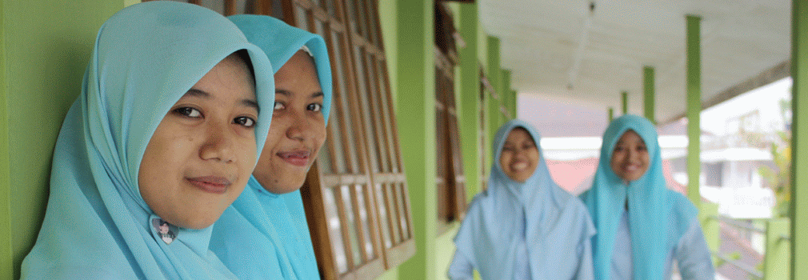
Session 3.9: Conflict Resolution in the Local Context
Session Objective:
Understand existing frameworks for conflict management and resolution in your local context.

Slide 124
Activity
You will receive a blank “Conflict Resolution in the Local Context” worksheet.
In small groups, complete this handout to the best of your knowledge.
Each group will share their responses.
We will then review a completed “Conflict Resolution in the Local Context” handout together.

Slide 125
Activity
In small groups, brainstorm:
  Any formal and informal conflict management institutions that you are aware of;
  At least five types of conflicts they manage; and
  The relationship between the IMs and conflict management institutions, especially official ones.

Slide 126
Reflection
What kind of conflicts are the identified institutions involved in?
What conflicts are those you cannot mediate as an IM and why?
What does competence mean for you?
What is the difference between a civil case and a criminal case ?

Slide 127
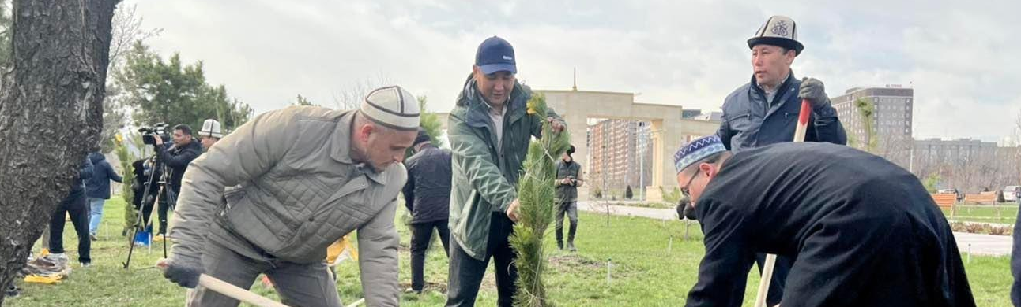
Session 4.1: Safety and Security Considerations Part 1 - Risk Assessments
Session Objective:
Understand and learn strategies to address elements of safety and security for the mediation and its participants.

Slide 128
Defining Safety and Security
Safety: The state of being away from hazards caused by natural forces or random human errors. The source of the hazard is formed by natural forces and/or human errors.
Security: The state of being away from hazards caused by the deliberate intention of humans to cause harm. The source of hazard is posed by humans deliberately.

Slide 129
Safety and Security
It is essential that the safety and security of all be paramount in planning any mediation, event, gathering, or even general travel.

Slide 130
Defining Safety and Security
Safety: The state of being away from hazards caused by natural forces or random human errors. The source of the hazard is formed by natural forces and/or human errors.
Security: The state of being away from hazards caused by the deliberate intention of humans to cause harm. The source of hazard is posed by humans deliberately.

Slide 131
Safety and Security Tenants
Safety and security has four key components that serve as guiding principles for evaluating any safe environment or event:
Tenant #1: Duty of Care: Presumes that individuals and organizations have legal obligations to act toward others and the public in a prudent and cautious manner to avoid the risk of reasonably foreseeable injury to others.
IMs have a moral, as well as a legal, responsibility and obligation for the health, safety, and security of everyone who is participating or involved in the mediation.

Slide 132
Safety and Security Tenants
Tenant #2: Informed Consent: You must work to provide appropriate information for participants such that they are able to decide for themselves whether or not it is safe to participate.
The overall goal of this is to be able to make an informed decision about whether or not they are comfortable in incurring the risks.
Staff and participants have the right to reject any assignment or task if they feel is too dangerous, they are uncomfortable with the safety protocol, or if they do not feel that they have the information to make that informed decision.
This is without any fear of reprisal or retribution.

Slide 133
Safety and Security Tenants
Tenant #3: Duty of Responsibility: All participants have the responsibility to the event and to the IM to ensure that they are actively and passively engaged in making the baseline of any meeting as safe and secure as it can be, and should not be in conflict with the process.

Slide 134
Safety and Security Tenants
Tenant #4: Do No Harm: Any event, planning, or coordination must not contribute to the future (or immediate) detriment to the location where the action is taking place, or to the nearby environment.

Slide 135
Safety and Security Risk Assessment: 6 Steps
Establish the context: Build an understanding of the societal and operational landscape as well as the security challenges and threats that exist.
Identify the risks: Identify all possible security and safety risks that could affect staff, programs, or the organization (including its reputation), and understand how, when, and why each threat might occur.
Analyze the risks: Assess each risk (threat and exposure to it) to determine its criticality and severity, likelihood, and the potential impact should it occur.
Evaluate the risks: Use understanding of the organization’s security risk exposure - if the IM is representing a larger organization - to make informed decisions on whether to accept certain risks or take additional actions to prevent or minimize them.
Treat the risks: Reducing the risk, transferring the risk to, or sharing it with, other parties, or ultimately avoiding the risk by not undertaking that activity.
Monitor and review: Continually review each component of the risk management process to ensure that current approaches and measures remain appropriate to the changing situation.

Slide 136
Ongoing Safeguarding Steps
The mediation team should take the following safeguarding (reducing potential for harm) steps:
Assign a safeguarding/safety and security focal point. The name and contact information should be clear and readily available to all.
Establish a confidential reporting mechanism for any concerns regarding safety, security, or safeguarding.
Identify resources and develop a referral list for any support or services that may be needed, based on the risk assessment above.
Communicate with participants and staff about the reporting mechanism, focal point, and resources available.

Slide 137
Reflection
What are the most common risks that you have or anticipate facing?
How have you addressed them? Or how might you address them in the future?
Were these measures sufficient? What else could have been done to reduce the risk?

Slide 138
Activity
Consider either a realistic upcoming mediation session or a fictional case study.
Identify 5-10 possible risks. Indicate the risk, how it would occur, when it would occur, and why it would occur.
Then, rate each risk by level of impact and probability:
  Impact
    Very Low (1): This risk has zero impact on the event, but should be noted.
    Low (2): This risk would have a low impact on the event.
    Medium (3): This risk would have a moderate impact on the event, and the measures implemented to address the risk should reflect the cost and impact of harm to an individual or organization.
    High (4): The negative impact of such an incident would be quite high, with substantial disruption or injuries resulting.
    Extreme (5): The impact of such an incident would be catastrophic for the event and even the conflict in general, and could encompass complete incapacitation for it.
  Probability
    Very Low (1): The probability of a risk occurring is essentially nil, or occurs once a generation.
    Low (2): The probability of a risk occurring is unlikely, perhaps once every 10 years.
    Medium (3): The probability of a risk occurring is possible, perhaps once every 2-3 years.
    High (4): The probability of a risk occurring is likely, perhaps once a year or more.
    Extreme (5): The probability of a risk occurring is essentially 100% - an incident is certain to occur.

Slide 139
Reflection
How did you find the process? How hard was it?
Do you feel you have a better sense of some of the challenges?
Did any of your ratings surprise you?
How do you communicate these with the participants?
We asked you to build your assessment team, and to do it quickly. Did that make the process harder or easier? Better or worse?

Slide 140
Biases in Risk Assessments
Two key biases in risk assessments:
Familiarity Bias: Focus on risks that are most likely and most impactful, not just the ones that make the news.
Impact to the Event: Consider how risks would impact the event and its participants itself, not the overall environment.
You should spend the majority of your time considering how best to mitigate risks that have the highest scores from this process, as they will have the most impact on its success.

Slide 141
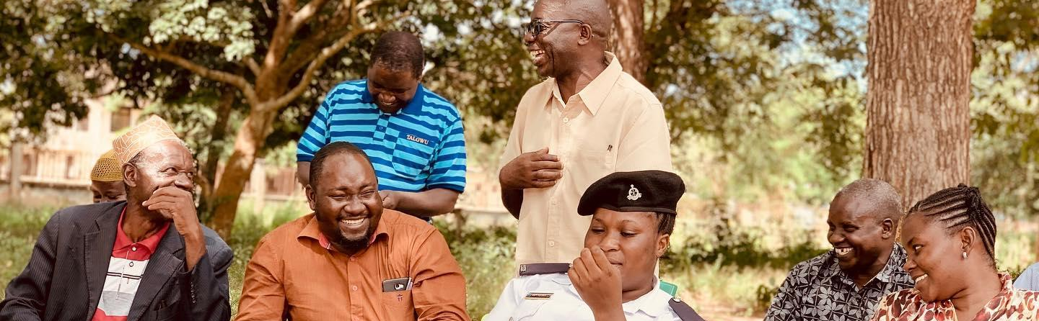
Session 4.2: Mental Health and Psychosocial Support for Insider Mediators
Session Objective:
Understand the importance of mental health and psychosocial support as insider mediators.
Learn approaches to take care of your mental health.

Slide 142
To achieve lasting peace, in the peaceful resolution of post-conflict situations, it is important to integrate trauma-focused psychosocial and mental health support.

Slide 143
Direct and Indirect Trauma
Trauma in the context of mediation can be direct or indirect.
An insider mediator may be directly exposed to traumatic stories, verbal or emotional abuse during mediation sessions, or indirectly affected by the tension generated by conflicts within the organization or community.
The mediator may also bring their own history of trauma, which makes being exposed to trauma during the mediations more difficult or triggering.
The resulting emotional overload can lead to severe psychological exhaustion.

Slide 144
Mediator Burnout
Mediator burnout is not only linked to the intensity of the conflicts themselves, but also to the way they resonate with their own experiences and emotions.
When mediators fail to take care of their own emotional boundaries, they risk prolonging the impact of conflict in their own lives, losing their objectivity and becoming progressively engulfed by stress, anxiety, and cynicism.

Slide 145
Understanding Stress and Trauma
Stress is the body's physiological adaptive response to our changing environment. Three essential phases characterize stress:
The body's alarm phase: As soon as it is confronted with a situation assessed as stressful, the body reacts immediately to prepare for fight or flight.
Resistance phase: Shortly after the first phase, if the stressful situation persists, the body enters a resistance phase against the invader. The body prepares for the energy expenditure required to respond to the stressful situation.
The exhaustion phase: If the stressful situation is prolonged or intensified, the body enters the exhaustion phase, as its capacities are overwhelmed.

Slide 146
Understanding Stress and Trauma
What are the effects of stress on the human body?

Slide 147
Symptoms of Chronic Stress
Physical symptoms: Pain, headaches, muscle aches, joint pains, etc., sleep, appetite and digestion disorders, unusual sweating, and more;
Emotional symptoms: Heightened sensitivity and nervousness, crying spells, anxiety, excitement, sadness, feelings of unease, and more;
Intellectual symptoms: Disturbed concentration leading to errors and forgetfulness, difficulty in taking initiative or making decisions, and more.
These symptoms have repercussions on behavior: Use of sedatives or stimulants, withdrawal, difficulty in cooperating, reduction in social activities, aggressiveness, and more.
If the stressful situation continues, the preceding symptoms set in or worsen, leading to physical and mental deterioration that may even be irreversible.

Slide 148
Understanding Trauma
Trauma is the individual's natural, adaptive reaction to a potentially traumatic event, and can have significant consequences for the individual's experience and behavior. Trauma is a high, prolonged and repeated level of alarm from the traumatic situation experienced in the past that leads to hypersensitivity to stress.
There may be a rupture:
  Relationship to things and the world: Meaning of life, death, age, profession, work, school, parenthood, money, home, independence, etc.
  Style and rhythm of life: Life on hold (impossibility of projecting into the future feeds anxiety), rupture of history (individual and collective).

Slide 149
Understanding Trauma
Post-traumatic stress disorder (PTSD) is a disorder that can develop following exposure to an event or series of events that are extremely threatening and horrific in nature, usually prolonged and/or repetitive, from which it is difficult or impossible to escape.

Slide 150
Understanding Trauma
Signs of trauma: Traumatic events and situations render us incapable of adapting and of understanding why in order to develop resilience measures.
We may experience nightmares, aggressiveness, agitation, fears, insomnia, isolation, hypervigilance, anxiety, difficulty concentrating, and more.

Slide 151
Indirect or Vicarious Trauma
Vicarious trauma is indirect trauma resulting from contact with the victims of traumatic events.
Vicarious trauma consists of profound changes experienced by the person who empathizes with trauma survivors and is exposed to listening to their traumatic journeys and experiences, and helping them to overcome the problems of everyday life.
This can lead to experiencing empathy fatigue or compassion fatigue.
Compassion fatigue can lead to exhaustion, burnout, and the inability of mediators to continue functioning effectively.

Slide 152
Consequences of Vicarious Trauma
On personal life: Through empathy, we see, smell, hear, touch and feel the same as the victim, listening to the latter recount his or her experiences in detail, with the aim of alleviating our own pain.
On professional life: These "vicarious traumas" cause profound ruptures in a person's sense of identity, worldview and spirituality.
At the level of emotional expression: Because it is exposed to the reality of cruelty by human beings towards other human beings, the IM can be affected, through its empathy, by the emotional effects.

Slide 153
Risk Factors for IMs
We may have a harder time as an IM if we have the following:
A history of violence in personal life;
High frequency of exposure to stories of suffering;
Little time for recuperation or self-care;
Poor management of stress and emotions;
High demands on self and others;
Avoidance behaviours linked to unresolved past trauma;
Inability to ask for help;
Little or no time for institutional reflection (supervision and analysis of practices);
No training on psychosocial support for mental health problems and trauma encountered in mediation work.

Slide 154
Case Study Activity: An Exhausted Mediator
Clément, a 45-year-old man, has been an insider mediator for over 10 years. He intervenes in sensitive neighborhoods, where he manages conflicts between neighbors, between different communities, and sometimes between residents and local authorities. His role is to ease social tensions, helping to resolve disputes, domestic violence, neighborhood conflicts or even ethnic tensions. Over the years, however, he has begun to experience chronic fatigue and emotional exhaustion due to the intensity and complexity of the conflicts he manages.
He found it increasingly difficult to become emotionally involved in the conflicts he managed. He began to feel that most conflicts were insurmountable, that the parties involved didn't want lasting solutions, and that his efforts were just a blindfold on an open wound. He began to doubt the effectiveness of mediation and to feel detached from the cause.
Clément becomes irritable, especially with those closest to him. Simple situations at home, such as trivial discussions with his wife or children, set him off more easily. His emotional reactions are disproportionate to events. When he's at home, he's often mentally absent, thinking about his mediation cases, unresolved conflict stories or stressful work situations.
Clément gradually isolates himself from his family, no longer actively participating in family activities, and often spends his weekends catching up on unfinished work or trying to rest, but to no avail, as his mind remains preoccupied with the conflicts of the week.
At work, he forgets to follow up on certain files, and feedback from colleagues and superiors is less and less positive. His colleagues have provided feedback that he has a decline in mediation quality, that their relationships with him feel strained, and Clément himself feels that it has become hard to work with his fellow mediators.
Discuss: How can we help Clément overcome this exhaustion?

Slide 155
The Importance of Emotional Intelligence (EI)
EI is a set of emotional and social skills that enable people to keep control of their emotions and make informed, conscious decisions that benefit themselves and their colleagues, rather than acting impulsively.
How is the skill of emotional intelligence relevant in the case of Clément?

Slide 156
Coping Strategies for IMs
Coping describes the reactions of an individual acting to produce cognitive and behavioral responses in order to control and moderate the impact of a stressful situation.
When trauma is brought up during a mediation, we need to assess the experience required to manage this situation.
Seeking social support, aimed at obtaining help, encouragement and/or sympathy from others, is a very important strategy for overcoming stressful situations and trauma.
IMs are not always capable of resolving all conflicts at all times, and the search for social support consists of involving another mediator and other people involved in the matter to support, appreciate or guide you.
Coping strategies can be both healthy and unhealthy. What are some examples of healthy coping strategies?

Slide 157
Coping Strategies for IMs
What are your coping strategies?
How can you take care of yourself?

Slide 158

Session 4.3: Understanding the Relationship Between Trauma and Conflict in the Mediation Process
Session Objectives:
Understand the impact of trauma and conflict.
Learn approaches to handling trauma among conflicting parties during a mediation.

Slide 159
Trauma and Conflict
As an insider mediator, we need to be aware of how trauma and conflict intersect and can impact the parties during your mediation.
In conflict, we may be unable to defend ourselves or those we love.
The consequence of this failure to defend oneself will be a deregulation of the entire defense system.
This is often what we label as fight, flight, freeze – our nervous systems can become stuck in hyperactivity, or can be completely deactivated, almost making us frozen. Or, we may flee at the first instance of conflict in the future.

Slide 160
Trauma and Conflict
Factors contribute to trauma and conflict:
Lack of support from those around them: People who lack this support find it very difficult to heal.
Recognition as a victim: If victims are doing well, they run the risk of lacking legal and institutional recognition and may try to claim this recognition through a variety of behavioral manifestations.
Negative impact of trauma on marital relationships: Communication deteriorates, strong emotional reaction, many marital break-ups, victims cannot stand family life, children inherit the trauma from parents, violence begets violence.
Added mourning process (loss of a loved one): Events that amplify the effects of the main trauma.
Negative interpretation of the trauma and/or its after-effects: The traumatized person understands that they are not the same as before and feels as though they do not recognize themselves.

Slide 161
Dealing with Trauma among Conflicting Parties during a Mediation
Use active listening and empathy to identify and deal with the individual traumas.
Be welcoming and gain trust by introducing yourself and having consistent communication and ensuring confidentiality.
Ask open questions instead of closed ones.
Listen more than you talk. Listen to both feelings and content.
Be aware of your own prejudices.
Manage your emotions by implementing coping strategies.
Be alert to ideas and problem-solving opportunities.
Send verbal and non-verbal messages that you are listening and avoid interrupting.
Have icebreakers or take breaks when needed.

Slide 162
Prevention of Indirect Trauma
Prepare a referral list/relationship/mechanism with different potential services and supports needed.
Be discerning when selecting the cases you agree to work on.
Clearly marking limits and boundaries according to one's abilities.
Prevention through regular debriefing, teamwork and peer supervision.
Limit the number of cases of violence handled each day.
Take it in turns to use the different methods of peaceful conflict transformation by involving colleagues in your work (group, individual).
Reflect in groups on the mediation case.
Forcing yourself to take real breaks during the day.
Practice your coping mechanisms identified in the previous session.

Slide 163
Case Study Activity: Clement
Clément, a 45-year-old man, has been an insider mediator for over 10 years. He intervenes in sensitive neighborhoods, where he manages conflicts between neighbors, between different communities, and sometimes between residents and local authorities. His role is to ease social tensions, helping to resolve disputes, domestic violence, neighborhood conflicts or even ethnic tensions. Over the years, however, he has begun to experience chronic fatigue and emotional exhaustion due to the intensity and complexity of the conflicts he manages.
Consider a specific scenario during a mediation that Clement helps moderate:
During a mediation, a member of one of the conflicting parties approaches Clement during the lunch break. She tells Clement that she has been having terrible nightmares because of how a family member was killed during the recent outbreak of violence. She tells Clement that she is trying to be present during the mediation but her mind keeps wandering. She begins to describe how her neighborhood was destroyed by the conflict. Clement begins to feel very overwhelmed.
What should Clement do? Discuss in small groups.

Slide 164
Session 5.1: Identifying Conflict Sources - The Circle of Conflict
Session Objective:
Learn the five different sources of conflict by understanding the Circle of Conflict.

Slide 165
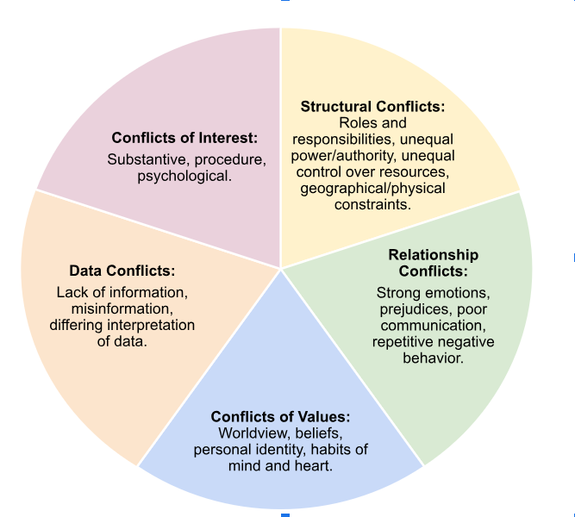
Identifying Conflict Sources - The Circle of Conflict

Slide 166
Activity: Case Study and Sources of Conflict
Referencing a case study:
Identify what aspects of the following types of conflicts are present: Conflicts of interest, structural conflicts, data conflicts, relationship conflicts, and/or conflicts of values? Write these on post-it notes.
Once you have which aspects of the conflicts are related to what type of conflict, stick the appropriate post-its in the correct slice of the Circle of Conflict at the front of the room.

Slide 167
Reflection
Which elements/issues in the circle contributed most to the conflict, and in what way?
How easy or difficult was it to identify the source of the conflict?
What lessons have you learned from this analysis with the Circle of Conflict?

Slide 168
Session 5.2: The Ladder of Conflict
Session Objective:
Learn the Ladder of Conflict and be able to use this tool to analyze a conflict.

Slide 169
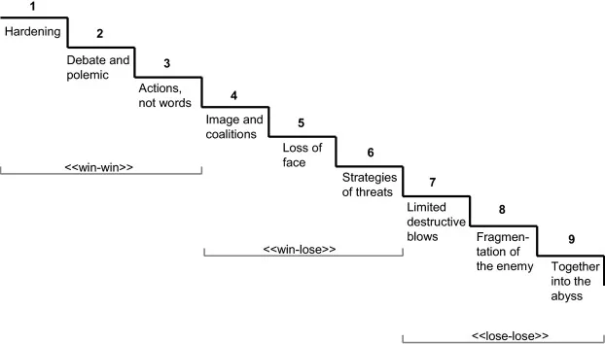
The Ladder of Conflict: Glasl's Model of Conflict Escalation

Slide 170
Activity: Case Study and The Ladder of Conflict
Referencing a case study, identify the aspects of the ladder in this conflict. Work together in small groups.

Slide 171
Session 5.3: The Actors, Content, Context, Process Framework (ACCP)
Session Objectives:
Learn the AACP framework and understand how to apply it to analyze a conflict.

Slide 172
The Actors, Content, Context, Process Framework (ACCP)
Step 1 - Actor Analysis: Actors are people, organizations, countries involved directly or indirectly in the conflict. When analysing actors, one asks the following questions:
Who are the primary parties directly engaged in the conflict?
Who are the allies and patrons of these parties?
Who are the relevant external actors (neighboring states, regional organizations, foreign powers?)
Who are the affected groups (ethnic communities, religious communities, women, youth?)
What are the current and historical relationships between the various groups?
What are the goals, positions, interests, and needs of the various groups?
Who are the leaders and how strong and unified is the leadership?
Are women and youth involved directly or indirectly in the conflict?

Slide 173
The Actors, Content, Context, Process Framework (ACCP)
Step 2 - Content Analysis: Content refers to all the issues that need to be addressed to resolve the conflict. They should be understood from the perspective of all the parties in the conflict. Analyzing content can be done by:
Identifying and clustering issues where there is agreement/no agreement, possibility of agreement, and tough issues;
Identifying the timeframe of each issue: short-, medium- and long-term issues;
Asking: What are the causes of the conflict–current and recent drivers of the conflict? What are the main structural causes of the conflict, i.e. the root causes? How do parties view the causes of the conflict? How are domestic, regional, and international causes related?

Slide 174
The Actors, Content, Context, Process Framework (ACCP)
Step 3 - Context Analysis: The meaning of conflict resides in its context, i.e. the background of the conflict, the systemic conditions behind conflict. This is when we ask: What else is important for us to know? This takes into account:
Social, economic, and political conditions and policies that feed the conflict;
Mapping context involves understanding key events that can change content;
What contextual topics are important to each side?
How can context influence the process?
How can regional and international actors influence the context?
What is the role of women and youth?

Slide 175
The Actors, Content, Context, Process Framework (ACCP)
Step 4 - Process Analysis: Refers to how the parties respond to the conflict: either non-violently or violently. Non-violent forms include negotiation, mediation, or dialogue. It is important to note that processes change over time whereby violence intensifies or when parties decide to turn to non-violent means. When analyzing process, one looks at:
Pre-negotiation phase to inform setting up a framework for negotiation;
Venue, timing, participation, and frequency of meetings;
Direct negotiation phase;
Mediator;
Implementation phase.

Slide 176
Activity
In small groups, identify a familiar conflict of your choice at any of the following levels: Community/local level conflict, provincial; organizational, national, or international.
Take 20 minutes to write on a flip chart paper:
  Identify the actors involved in the conflict (women, men, and youth);
  Identify the content-issues/causes of the conflict;
  Identify the context in which the conflict resides?
  Identify the processes.
Each group will report out.

Slide 177
Reflection
Can you tell how this process has helped you understand the conflict better/deeper?
Have you been able to figure out how different actors define the conflict?
During the exercise, has anyone noted a change in content, context, and process?
How may understanding of the actors, content, context, and processes help in the design of a mediation process?

Slide 178
Session 5.4: Dialogue as a Conflict Transformation Tool
Session Objective:
Learn what dialogue is, the process of dialogue, the needed qualities and skills of facilitators, and approaches to address intractable issues.

Slide 179
Dialogue as a Conflict Transformation Tool
According to the Berghof Foundation, dialogue is “A face-to-face interaction between people with different backgrounds, convictions and opinions, in which they respect each other as human beings and are prepared to listen to – and learn from – each other deeply enough to inspire a change of attitudes.”

Slide 180
Dialogue as a Conflict Transformation Tool
Dialogue is not debate. In debate, we try to convince the other party that we are right. In dialogue, there is no right or wrong.
A dialogue requires trusted facilitators – They should always be seen as impartial and unbiased among participants.
Participants should be aware of what they are agreeing to participate in and that this is a process of building trust, being transparent, engaging in partnership, active listening, being curious, and following up.
Facilitators promote inclusion, ask context-specific questions, build trust, model transparency, and more.

Slide 181
The Dialogue Process
The dialogue process entails a series of meetings between two or more actors across the conflict lines with the intention of exchanging perceptions and building understanding and trust. Important factors include:
  Size of dialogue groups: A minimum of eight participants should be involved.
  Spaces for dialogues: A dialogue’s setting and space are often determined by the local conditions and cultural standards. All participants should have direct eye-contact with each other, can listen to each other easily, and that there is no hierarchical difference in the seating.
  Refreshments: Participants usually appreciate it when the organizers or hosts provide some refreshments.
  Time management, sessions, and breaks: Each culture has its own standards with respect to punctuality, the lengths of the sessions, and the breaks.

Slide 182
The Dialogue Process: Pre-Dialogue
Preparatory meetings and setting the agenda:
Draft the agenda for the individual sessions as well as the overall, sustained dialogue process.
Start with topics on which at least some degree of procedural consensus can be achieved with some ease.
More difficult issues should be addressed at a later stage.
At the early stages of dialogue, there may be less divergence and more positive expectations and expressions of harmony.
Over time, the opinions differentiate and issues broaden (complexify) – both in a positive and negative sense.
Towards the end of a dialogue, and often aided by good facilitation, issues and opinions converge again and, ideally, emerge in a general consensus.

Slide 183
The Dialogue Facilitation Phases
Phase 1: Getting to know each other and defining/elaborating issues.
Setting ground rules together. This should be done at the very beginning of the first dialogue session and should be explicitly confirmed by all participants.
These ground rules should be disseminated in written form, so that participants and facilitators can refer to them whenever necessary during the dialogue process.
The participants elaborate the issues to be dealt with in the respective working group and to give all parties/representatives the opportunity to present their perspective on these issues.

Slide 184
The Dialogue Facilitation Phases
Phase 2: Deepening of understanding and sharing perspectives.
Only after all the parties/representatives have put forward their perspectives and opinions on the issues at stake should you move on to the second phase, the deepening of understanding and the sharing of perspectives.
This is the most difficult phase in all dialogues but it is also crucial for moving towards a common ground and for triggering compromises.
Helpful in this phase is to acknowledge underlying feelings, concerns, fears and needs of all parties and encourage mutual understanding.
o do this, one can use open-ended and circular questions, reframing and mirroring.

Slide 185
The Dialogue Facilitation Phases
Phase 3: Generating inclusive options.
A good indicator for the successful sharing of perspectives is when a party/representative expresses their surprise about an insight or softens the stance on a controversial topic.
his can be the starting point for the third phase which focuses on generating options that allow both sides to gain something from the conflict.
During this phase it is crucial not to evaluate these options immediately, but to create an atmosphere conducive to open-minded brainstorming and to encourage a broad spectrum of creative alternatives.

Slide 186
The Dialogue Facilitation Phases
Phase 4: Discussing and evaluating options.
Only after phase three is concluded, it is recommended to move to the fourth phase of discussing and evaluating the options.
To prepare this phase, it is useful to put together a list of criteria that are most suitable with respect to a reasonable consensus.
Post dialogue: Any action that needs to be taken is implemented.

Slide 187
Dialogue Facilitation
What do you think the basic requirements for dialogue facilitators are?
Would there be a difference in requirements for insider facilitators/IMs? Why (not)?
What challenges and opportunities do you see for insiders to facilitate dialogues?
How would you determine who would be an appropriate facilitator for a dialogue?

Slide 188
Guidelines for Facilitators
  Neutrality/multi-partiality: Someone who has no decision-making authority to support their efforts in finding a common solution in a fair manner.
  Strong listening, reframing & summarizing skills: Need to be able to listen carefully during all phases of the process, to summarize long statements and occasionally reframe statements.
  Formulating good questions: Ask questions that encourage participants to share the background and underlying needs, fears and interests of their statements and proposals.
  Personal integrity and awareness: Good facilitators combine personal integrity with a strong awareness of their own strengths and weaknesses as facilitators.
  Understanding group development as a dynamic and holistic process: Good facilitators are aware that ups and downs are normal phenomena in group settings.

Slide 189
Guidelines for Facilitators
Which of the necessary skills and qualities from what we just reviewed do you feel most confident in and which do you find most challenging and why?

Slide 190
Tools to Deal with Difficult Situations and Deadlocks
First-aid empathy
Remind participants of the principles and ground rules of dialogues
Have creative breaks
Establish a sound knowledge base accessible for all participants
Mobilize external expertise
Initiate multipartial deadlock-breaking team(s)
Introduce creative tools into the dialogue, e.g. “fishbowl” sessions
Take self-care measures
Strategically co-facilitate
Elicit Visualization

Slide 191
Session 5.5: Understanding Negotiation
Session Objective:
Learn what negotiation is and understand its application.

Slide 192
Understanding Negotiation
Negotiation is a method of resolution of issues or conflicts that we use every day, either with ourselves or others.
It can be a means of communication designed to reach an agreement when you and the other side have some shared and some opposing interests.
It can also be an intervention strategy for the transformation of a larger conflict through a process of talks between conflicting parties without the support of a third party.

Slide 193
Types of Negotiation
Soft negotiation: Participants are friends or have a standing relationship which is positive. The goal is to reach a mutually acceptable agreement and build/strengthen sustainable relationships. Parties essentially have some level of trust in one another and are willing to lose something for the sake of reaching agreement.
Hard negotiation: The participants are often adversaries and each participant’s goal is to win and be the victor. They do not prioritise relationships, but instead make demands as a condition for establishing a relationship. This kind of negotiation presents challenges such as:
  Entrapment – the more you defend your position the more entrenched you become;
  Inefficient outcomes -time and cost of reaching an agreement is high;
  Relationships are harmed or destroyed;
  Win/lose outcomes.

Slide 194
Types of Negotiation
Interest-based negotiation: Considers the interests of the parties to a conflict over their positions, which are often concrete and pre-determined. These interests include needs/concerns, fears, and hopes of all parties involved.
It is important to identify the needs of each and make the meeting of those needs a shared problem - a unified mission for the conflicting parties. While keeping interests in mind:
Define and unpack the problem;
Expose shared, compatible and divergent interests behind positions;
Realize that parties can have multiple interests;
Recognise basic human needs;
Acknowledge common and diverging interests of others;
Focus on the future not the past;
Be concrete, but flexible;
Be hard on the problem, soft on the people.

Slide 195
Best Alternative to a Negotiated Agreement (BATNA)
Should an agreement not be reached, what is the best alternative option for each side?
The BATNA is the best “walkaway option”, i.e. the best option parties can achieve away from the negotiating table.
Tips to Identify your BATNA:
      Know and evaluate your alternatives;
      Focus on what you want to achieve and the different ways to achieve this;
      Construct your BATNA to be more achievable, probable, or satisfying more of your interests;
      Consider the other side’s BATNA.

Slide 196
Activity: Mock Negotiation
Consider this scenario: A character wants to sell their property/piece of land for USD 110000. They have three interested buyers but none are prepared to part with USD 110000. The seller gets three offers:
  USD 90000 one-off payment;
  USD 95000 in installments over a period of three months;
  Another property worth USD 100000 in a better suburb.
Divide into four working groups who will each represent one of the parties in the negotiation. You will decide what your party’s BATNA is without knowing yet what the other parties’ BATNAs are.
As a group, discuss and identify your BATNA and get ready for a negotiation.
After 10 minutes, identify one person whom you will send to the negotiation table.
The seller will then meet and negotiate with one member from every group while others observe.

Slide 197
Reflection
As you were identifying your BATNA, what other alternatives came into your mind?
Before settling for what you say is your BATNA, what considerations came to your mind?
From your analysis, what are the BATNAs of other parties in the negotiation?
During the planning for the negotiation, did you plan at what point you would reveal your BATNA?

Slide 198
Session 5.6: Gender Inclusion in Mediation
Session Objectives:
Understand why gender inclusion is so important in mediation and learn strategies to include women.

Slide 199
A father and his son are out driving and are involved in a terrible accident. The father is killed instantly, and the son is in a critical condition. The son is rushed to the hospital and prepared for an operation that could save his life. The surgeon comes in, sees the patient, and exclaims, “I cannot operate on this boy… he's my son!”
How can this be?

Slide 200
Reflection
Were you surprised about the answer? And about other participants’ answers?
Does our cultural background shape our answers? What other factors may determine the answers we provide to this riddle?
What other gender biases and misperceptions are there in our society?
What do such gender biases mean for exclusion and inequality?
Apart from gender biases, what other biases are there in our society that lead to exclusion of certain intersections of society?

Slide 201
Gender Inclusion
UN Guidance on Gender and Inclusive Mediation Strategies describes the importance of women and youth inclusion in mediation as follows:
“Women’s and youth participation can expand the range of domestic constituencies engaged in peace, strengthening its legitimacy and credibility.
Women’s and youth perspectives bring a different understanding of the causes and consequences of conflict, generating more comprehensive and potentially targeted proposals for its resolution.
Peace agreements that are responsive to the specific needs of women and girls, men, and boys, contribute to sustainable peace”.

Slide 202
Gender Inclusion
Strategies for women inclusion in mediation:
Adopting a quota system.
Putting in place the selection criteria and procedures.
Building trust in women and youth.
Overcoming women and youth challenges.

Slide 203
Activity
In small groups, discuss:
How are women currently involved in mediation processes in your community? What are the reasons behind their involvement as mediators?
Is the environment conducive to their participation? If not, what could be the reasons? How can the participation of women in mediation be improved?

Slide 204
Reflection
What common themes and challenges were identified during the group discussions?
What practical solutions were proposed to improve gender sensitivity in mediation processes?
How feasible and effective do you think these solutions are?
What can you do, as a mediator, to ensure that women are included and their perspectives are heard in mediation?

Slide 205
Session 5.7: Youth Inclusion in Mediation
Session Objectives:
Understand why youth inclusion is so important in mediation and learn strategies to include youth.

Slide 206
Youth Inclusion in Mediation
UNSC Resolution 2250 sets the Youth, Peace and Security agenda and suggests five pillars:
Participation: Are youth participation and views taken into account in every part of decision-making processes?
Protection: Ensure protection of youth from violence and human rights abuses and make sure to prosecute those who have committed crimes.
Prevention: Support youth in the prevention of violence and in building a culture of peace and tolerance.
Partnership: Engagement of youth in the design of peacebuilding strategies.
Disengagement & Reintegration: Investment in youth through creating employment opportunities, inclusive labor policies and peace education.

Slide 207
Youth Inclusion in Mediation
A three-layered approach is useful to make sure that the inclusion of youth is meaningful:
Working for youth as participants: Invest in capacity-strengthening of youth for peacebuilding and mediation if needed and create an infrastructure where youth will have more easy access to participating and leading in peace and mediation processes.
Collaborating with youth and engaging with them as partners: Encourage intergenerational partnerships and make sure to partner with youth (organizations).
Supporting youth as leaders: Are youth part of mediation teams or used as a resource by serving as Insider Mediators?

Slide 208
Youth Inclusion in Mediation
Some people say that they wouldn’t know where to find qualified youth. How would you go about identifying youth suited to be insider mediators/peacebuilders?

Slide 209
Youth Inclusion in Mediation
What would a youth-sensitive conflict analysis look like?
What would the approach be?
What would the assumptions be?
What would the questions be one would ask?

Slide 210
Activity
In small groups, discuss your thoughts and write down your responses on different color post-it notes for the following questions:
  What obstacles have you experienced for youth inclusion in mediation and peace processes?
  What special opportunities do you see for youth to enrich peacebuilding and mediation processes and complement older people in these processes?
Pin your answers on post-its to two different flip chart papers for obstacles and opportunities.

Slide 211
Session 5.8: The Role of Advocacy
Session Objectives:
Enable inside mediators to understand the key concepts and fundamentals of advocacy, including the different importance of advocacy in any conflict management process, particularly in mediation.
Participants will be able to use the knowledge acquired to carry out advocacy in your communities.

Slide 212
The Role of Advocacy
Advocacy is a deliberate process aimed at influencing decision-makers on the development, change and implementation of policies or laws in favor of people and/or communities affected by a given problem or situation.
It is a strategy mainly used by civil society organizations (CSOs) and non-governmental organizations (NGOs) in the defense of a cause and to achieve a desired change.
Use advocacy to:
Solve a problem, propose a solution
Influence decision-makers on development, change and policy implementation
Change in favor of those affected
Change of attitudes and behaviors.

Slide 213
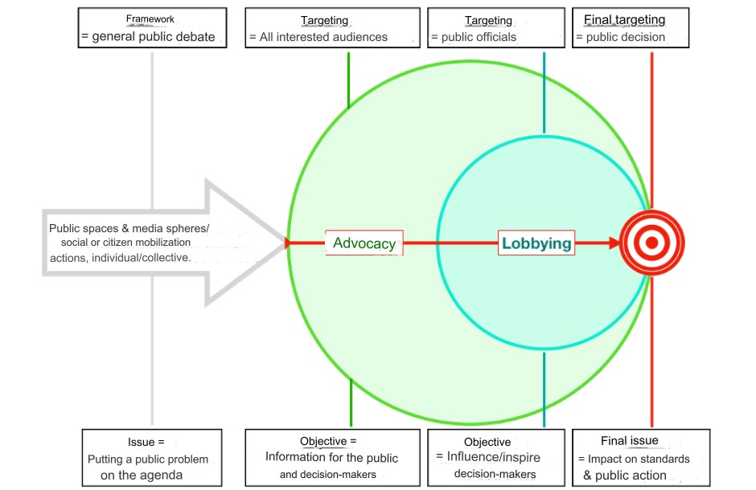

Slide 214
Advocacy | Lobbying
Inform (or raise awareness of) parliamentarians about the impact of a policy on their constituents. Use social networks to make known a cause or issue. Meet with a member of the government to explain how a particular issue affects a group, community or organization, the environment, etc. Invite a minister or parliamentarian to visit a company/NGO to see for themselves how government policy affects its activities. | Ask a member of parliament to vote for or against a law Prepare documents (online petitions, for example) or organize events (demonstrations, conferences, etc.) to support or oppose a government decision, a law, etc.

Slide 215
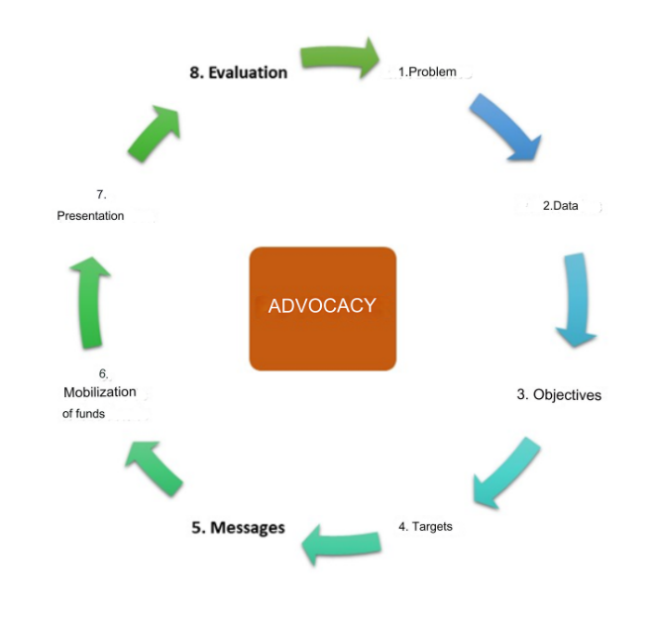
The Advocacy Cycle

Slide 216
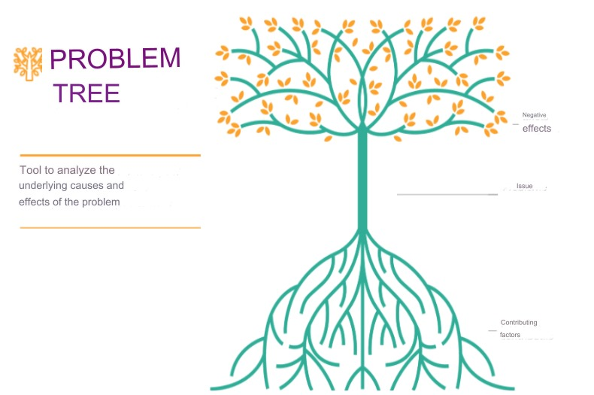
The Advocacy Cycle
Step 1: Defining or identifying the problem to be solved.
This involves not only identifying the main problem (what needs to be changed), but also its underlying causes and consequences. The problem tree is the tool used for this analysis.

Slide 217
The Advocacy Cycle
Step 2: Gather contextual data.
The problem to be solved is never isolated. It is part of a political, economic, cultural and other context, which we need to understand well.
It would be difficult, if not impossible, to develop a realistic and achievable advocacy action without taking into account the context in which the problem is situated.

Slide 218
The Advocacy Cycle
Step 3: Defining objectives.
An objective is what we want to achieve, what we want to see changed by the advocacy action we have initiated.
It responds to the main problem and must be SMART in order to guide those carrying out the advocacy action.
A good objective clearly states what change is intended, by whom, to what extent and when.
S | Specific: Defined as precisely and concretely as possible as to what will be achieved, by whom, how, with what means, when, and why.
M | Measurable: Not hidden behind words but whose quantity and quality can be measured and evaluated.
A | Achievable: Objective that you are sure you can achieve, within the reach of the means available.
R | Realistic: Check that there are the necessary resources (human, material, financial, etc.) to achieve the objective.
T | Temporal: Defined and time-limited.

Slide 219
The Advocacy Cycle
Step 4: Identify advocacy targets. There are three types of advocacy target:
Primary targets: The person(s) who has/have the authority to produce the desired change(s).
Secondary targets: who have the ability to influence the primary targets, especially when it is difficult or impossible to reach the primary targets. They can be friends, family members, advisors, religious leaders (moral authority), and even mediators.
Primary stakeholders: those affected by the identified problem(s).

Slide 220
The Advocacy Cycle
Step 5: Develop key advocacy message(s).
The advocacy message is a clear and convincing statement of the purpose of advocacy.
It tells the target what it is being asked to do, why it is being asked to do it, and what positive impact the action will have.
An advocacy message can take many forms: letters, brochures and leaflets, radio or television broadcasts, press releases, banners, etc.

Slide 221
The Advocacy Cycle
Step 6: Mobilizing resources.
To carry out a successful advocacy campaign, it is essential to know what capacities exist, what financial and human resources are available, and what potential sources of funds are available to finance the advocacy action.
With all this information, it will be easier to develop a budget that takes into account available funds, workforce, in-kind contributions, supplies and equipment.

Slide 222
The Advocacy Cycle
Step 7: Action plan and implementation.
Advocacy activities are developed and implemented.
A logical framework can be developed to help visualize the relationship between advocacy objectives, the activities that contribute to their achievement, and indicators to measure the achievement of objectives.

Slide 223
The Advocacy Cycle
Step 8: Evaluation.
At the end of an advocacy action, the extent to which the advocacy objective(s) has (have) been achieved is assessed.
The change achieved in relation to the objectives set is measured.
This step provides an opportunity to reflect on how to improve the capacity of the action.

Slide 224
Activity
Think critically about a problem you have observed in you community that could benefit from advocacy efforts. Analyze the chosen community problem using this table:
Problem | Causes | Consequences | Implication for Advocacy

Slide 225
Reflection
What were the common themes or recurring issues identified during the problem analysis?
Were there any surprising insights gained from the analysis?
How does understanding the causes and consequences of the problem help in formulating effective advocacy strategies?
What role does stakeholder engagement play in addressing the community issue through advocacy?

Slide 226
Advocacy and Mediation
Problems can prevent an agreement from being reached in mediation. These advocacy actions may help:
Capacity building: Developing or reinforcing skills or instincts by sharing the knowledge needed to tackle a given problem.
Awareness-raising: Stimulating critical awareness by providing information that targets do not have, and thereby encouraging the adoption or implementation of strategies or policies that respond to the situation we want to change.
Public campaigns: Talking to others about a situation or problem to encourage them to take action.
Media actions: Messages disseminated through the media increase the number of people aware of the situation or problem.
Lobbying actions: Exerting pressure on targets (e.g. officials) with clear messages in official letters, through demonstrations, etc.
Resource mobilization: Strengthen collaboration between the various actors involved.

Slide 227
Session 5.9: Integrating the Environment, Climate Change, and Conflict Nexus
Session Objectives:
Understand how interconnected and important the environment, climate change, and conflict are, how to analyze the Nexus, and approaches to strengthen the nexus.

Slide 228
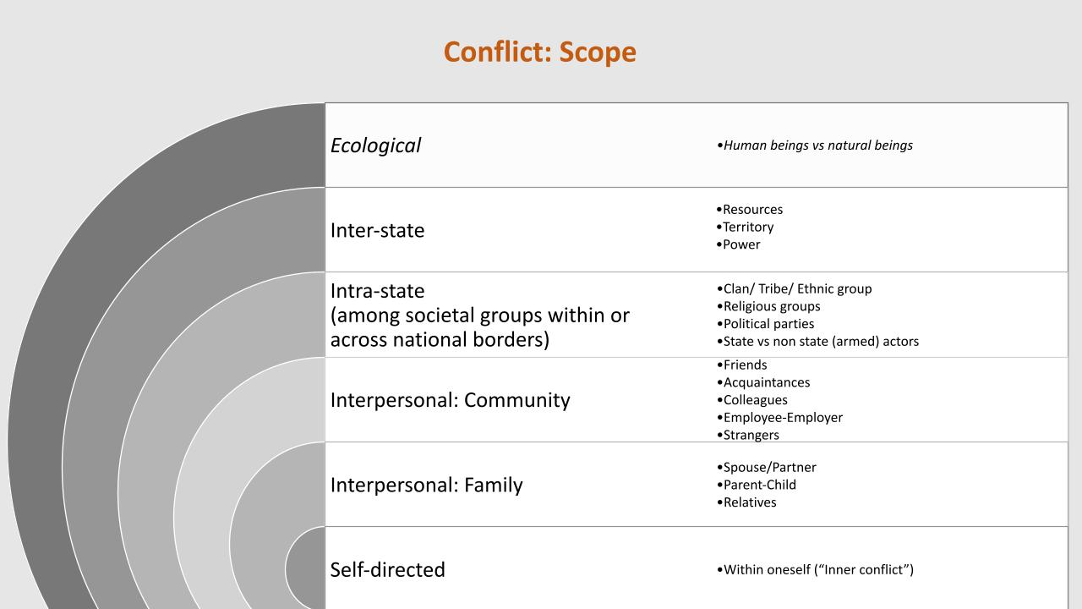
Integrating the Environment, Climate Change, and Conflict Nexus

Slide 229
Reflection
Is there a Human-Environment conflict?
What is the violence in Human-Environment conflict? How does this relate to climate change?
What are the Human-Environment relationships in conflict? In peace?

Slide 230
Reflection
How has the environment you live in affected your lives?
How has it shaped your culture and spirituality?
How does its change affect the community beyond the material aspects?

Slide 231
Defining the Nexus
The environment, climate change, and social behaviors, like conflict, interact in a complex system.
We define this as a triple-nexus. In this session, we will be referring to this simply as the “nexus.”
Each element of that complex system stands in a relationship to each other.

Slide 232

The Nexus

Slide 233

The Nexus

Slide 234
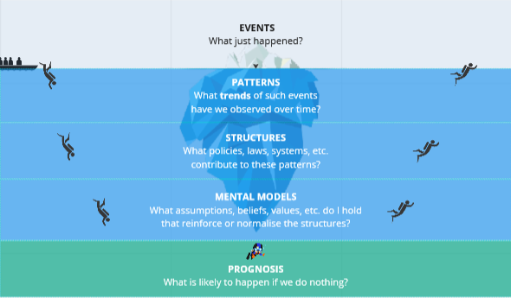
The Nexus

Slide 235
Activity
What is at the surface – what are the events?
What are the patterns that are just under the surface?
What are the mental models.
What do you think will happen if we do nothing?
What could we do?
  We need to shift our mind-set from reacting to events (symptoms) to pro-acting by:
    Transforming mental models: Ask ourselves: How should we change our thoughts? What is a more equitable perspective? How can it become better? Who do we need to consider?
    Transforming structures: How can we restructure our complex system? How can we build more inclusive structures? How can we consider the environment and climate change as part of these new structures?
    Potential impact over time: The patterns discussed earlier would change for the better, leading to less occurrence of the adverse events.

Slide 236
Activity
In small groups:
Identify an example of the nexus in your communities.
On the flipchart, draw a similar iceberg with the different layers.
For each layer, discuss and list the keywords. Remember to consider vulnerabilities, like gender, age, and other factors.
Present your iceberg to the large group.

Slide 237
Reflection
What was your experience during this exercise? What did you feel at the beginning? What did you feel at the end? Were you able to bring in an example from your home?
What was challenging? What was easy? What emotions came up?
Were you able to consider the environment and climate change? In what way or why not?
How was your thought process during the transformative side of the iceberg? What feelings came up? What was striking?

Slide 238
A Basic Framework for Environmental Peacebuilding
Focus on two spheres: our mental models, and our structural models.
Mental Models:
  Promote our human-environment relationship; human-human relationship; and our human-environment-human relationship.
Structural Models: institutions, policies and laws, services, infrastructure,
  What institutions/entities do we need or create or strengthen? How? Ministries, citizen forums, etc.
  What policies/laws do we need or create or strengthen? How?
  What services do we need or create or strengthen? How?
  What infrastructures do we need or create or strengthen? How?
  What mechanisms do we need or create or strengthen? How?
  What tangible and intangible resources do we need to mobilize? How?

Slide 239
Session 5.10: Safety and Security Considerations Part 2 - Facility Assessments
Session Objectives:
Understand and learn strategies to address elements of safety and security of the facility where the mediation is held.

Slide 240
Facility Assessments
It is vital to consider the suitability, safety, and security of any facility you are using to host an event.
Consider different identity groups and risk factors.
Review the Facility Assessment checklist.

Slide 241
Activity
In small groups:
Complete a facility assessment of this location.
Leave the meeting room and examine the property as much as is polite and respectful of its current business outside of the training.
Take notes and return in 30 minutes to each provide a brief share-out of what you found.

Slide 242
Reflection
How did you find the process? How hard was it?
Do you feel you have a better sense of some of the challenges?
Did any of your findings surprise you?
How would you communicate these with the participants?
Does this activity prompt any reflection on other locations you have visited as part of a mediation?

Slide 243
Thank you for your attention!

