Slide 1


^{Project Risk Planning}
Appendices

Slide 2
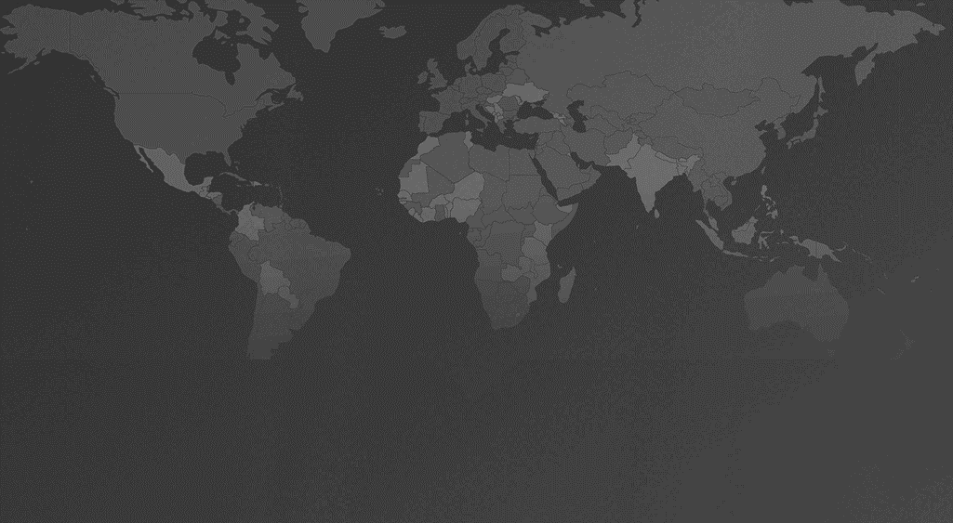
Appendix A: Risk Management Process
Plan risk management
Analyze risks
Plan risk responses
Monitor and control risks
Identify risks

Slide 3
Appendix B: Control over Sources of Risk (example)
Risk sources | Low control | Medium control | High control
Internal to project |  | Project scope | Management
Internal to organization |  | Implementer's procedures
External | Technology Travel requirements Global events Political environment Local regulations | Partners

Slide 4
Appendix C: Risk Impact Definitions (template)
Impact​ | Definition​ in relation to the project | Weight?​
High​ | ​ | ​
Medium​ | ​ | ​
Low​ | ​ | ​

Slide 5
Appendix D: Impact-Probability Matrix, Weighted (template)
 | ​ | IMPACT​
P​ R​ O​ B​ A​ B​ I​ L​ I​ T​ Y​ | ​ | High (6)​​ | Medium (4) | Low (2)​
 | High (4) | 1^{​st} priority | 3^{​rd} priority | later
 | Moderate (3) | 2nd priority | 4th priority | later​
 | Low (2) | 4th priority | later​ | later​

Slide 6
Appendix E: Risk Response Strategies
Accept
Move risk response out of the project and onto higher authority in the organization or further out
Threat is outside the scope of the project
Mitigate
Sources of risk hard to control
Shift ownership of threat to a third party to manage risk and bear impact (at a premium)
Low probability, low impact
No proactive steps or a contingency reserve
Avoid
High probability
Action to reduce probability of occurrence or severity of impact
Damage control after threat occurred
Transfer
Sources of risk easier to control
Change some aspect of project, management, objective to reduce risk probability to zero
Escalate

Slide 7
Appendix G: Risk Response Plan (template)
Threat | Source | Priority | Impact Scenario | Response strategy | Response actions | Response timeline | Risk owner | Decision authority
Staff emails are hacked | ​Government-sanctioned actors in country XYZ | ​2 | Names of staff, partners become known to nefarious actors, resulting in a smear campaign or direct threats | Avoid | Develop custom email protocol: - use separate email addresses for each activity/partner - use two-factor authentication - delete emails with sensitive info after securely archiving (etc.) | Two weeks post-award | Senior project officer | Project director
 | ​ | ​
 | ​ | ​

Slide 8

Freedom House 1850 M Street NW 11th Floor Washington, DC 20036
freedomhouse.org
@freedomhouse

